Slide 1


Christian Marchiori
Fabio Zanini

Slide 2
Dataset

Slide 3
Dataset
https://www.kaggle.com/datasets/rohanrao/formula-1-world-championship-1950-2020
The dataset consists of all information on the Formula 1 races, drivers, constructors, qualifying, circuits, lap times, pit stops, championships from 1950 till the latest 2023 season.
https://ratings-api.ea.com/v2/entities/f1-23-drivers-ratings
https://github.com/toUpperCase78/formula1-datasets
Driver Ratings from EA & Codemasters F1 2021 / F1 22 / F1 23 Official Video Game
https://github.com/Imagin-io/country-nationality-list/tree/master
csv file that maps countries to nationalities.

Slide 4
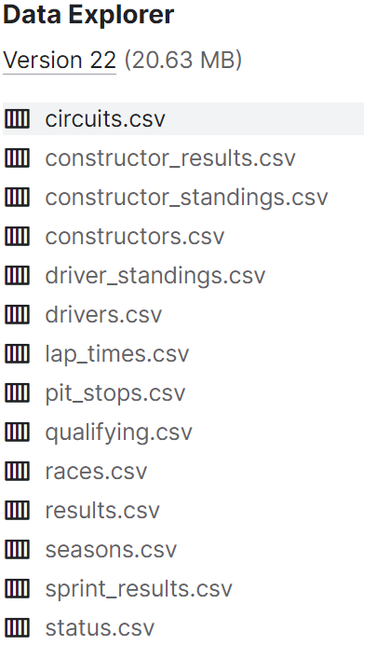
Dataset
circuits.csv (circuits where F1 races are held)
constructor_results.csv (race results of the constructor's championship)
constructor_standings.csv (final standings of the constructor's championship)
constructors.csv (constructors in F1)
driver_standings.csv (final standings of the driver's championship)
drivers.csv (drivers in F1)
lap_times.csv (lap times in F1)
pit_stops.csv (pit stops in F1)
qualifying.csv (qualifying in F1)
races.csv (races in F1)
results.csv (results of F1 races)
seasons.csv (seasons of F1)
sprint_results.csv (results of F1 sprint races)
status.csv (Mapping of various statuses)

Slide 5
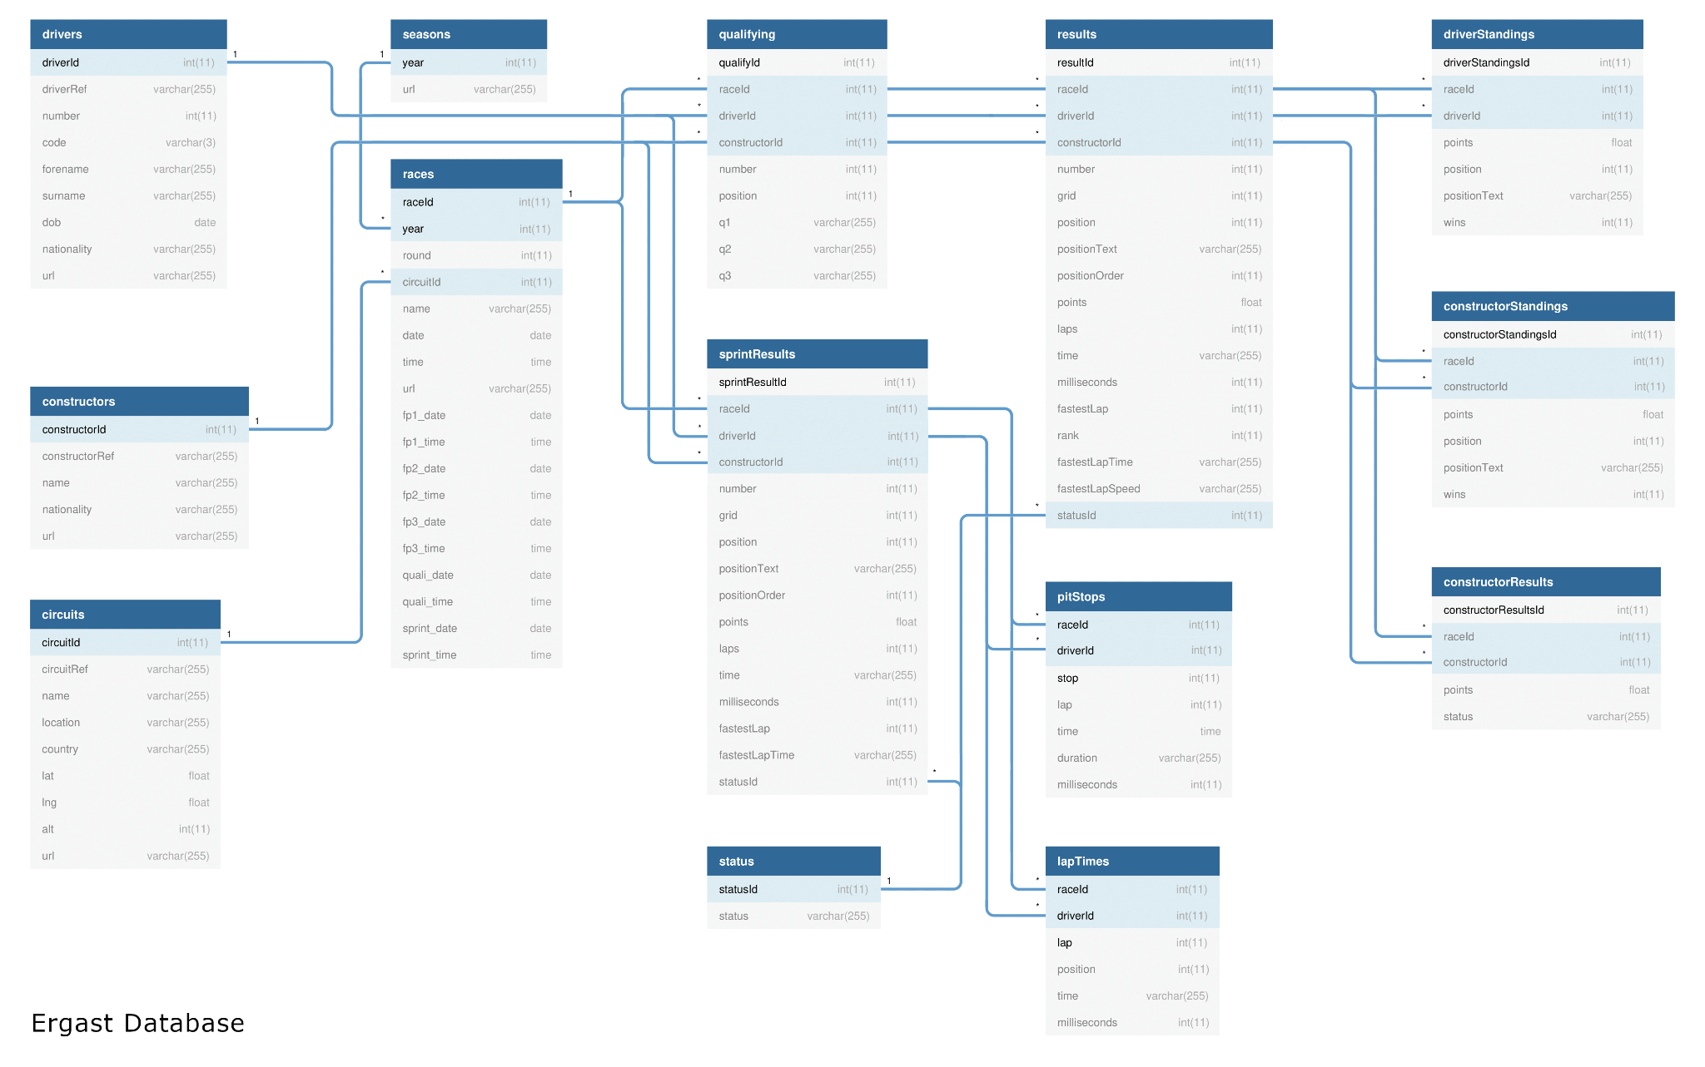
E-R Schema

Slide 6
Ontology

Slide 7
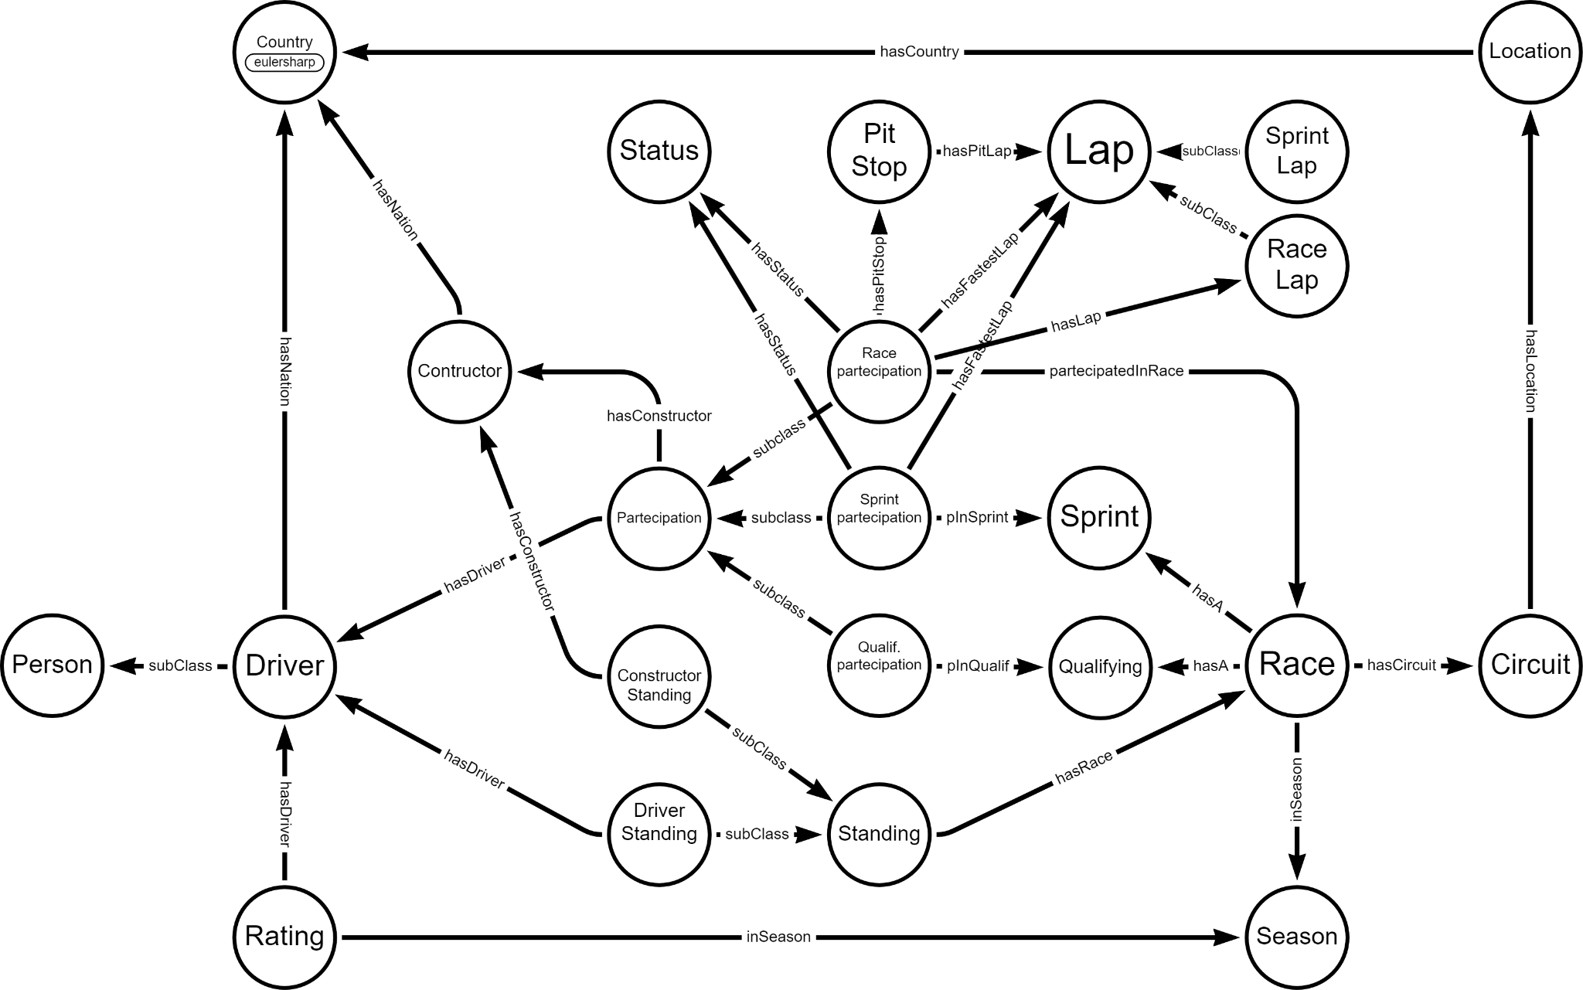
Graph Schema

Slide 8
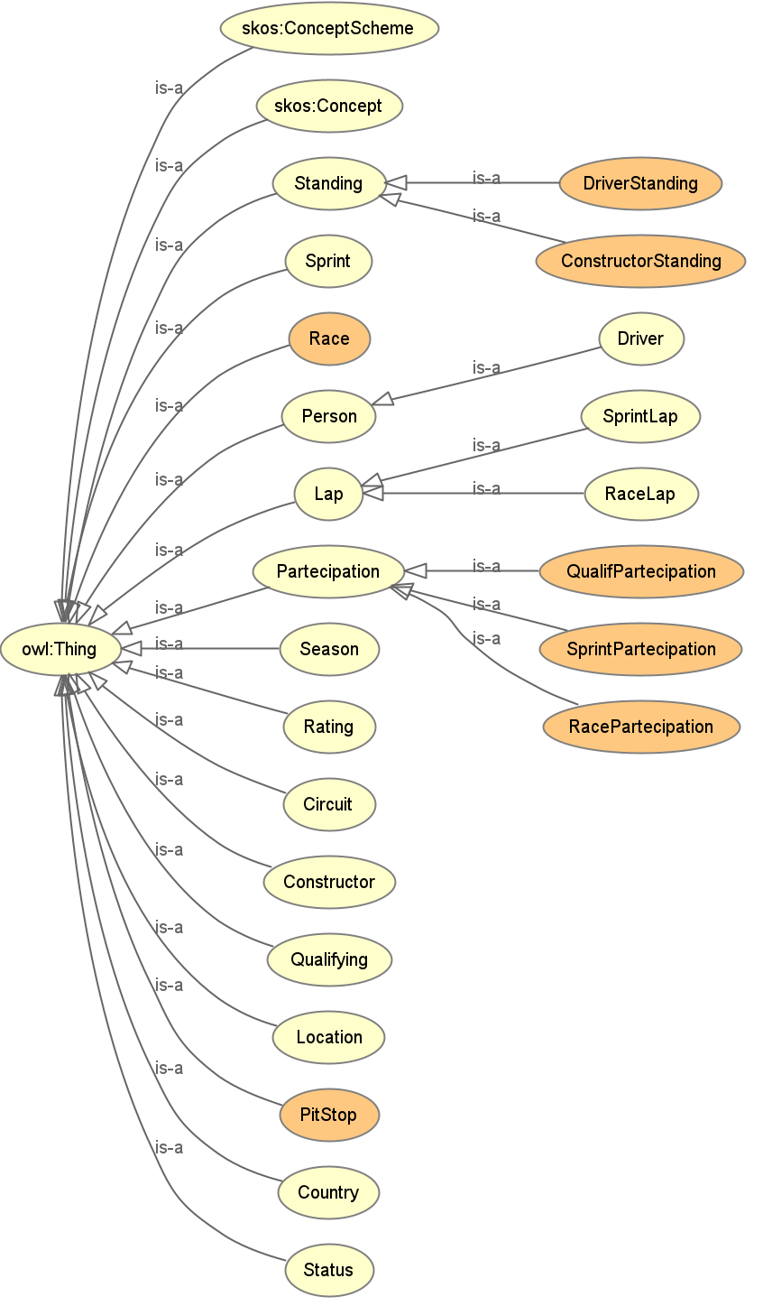
Ontology - Class hierarchy
Standing (represents championship standings)
DriverStanding (...related to drivers)
ConstructorStanding (...related to constructors)
Sprint (represents a sprint race related to a particular race)
Race (represents a particular F1 race)
Person (represents a person in general)
Driver (represents a F1 driver)
Lap (represents a single lap in a generic race)
SprintLap (represents a single lap in a sprint)
RaceLap ((represents a single lap in a race)
Partecipation (represents the participation of a driver and his related constructor team to a race/sprint/qualifying
QualifPartecipation (...to a qualifying)
SprintPartecipation (...to a sprint)
RacePartecipation (...to a race)
Season (represents a F1 season)
Rating (represents a rating tab for a driver)
Circuit (represents the circuits on which F1 races are done)
Constructor (represents F1 teams)
Qualifying (represents a qualifying related to a particular race)
Location (represents the location/city of a circuit)
PitStop (represents a single pitstop in a F1 race)
Country (represents world countries)
Status (represents a status of a driver or a car in a race/sprint)

Slide 9
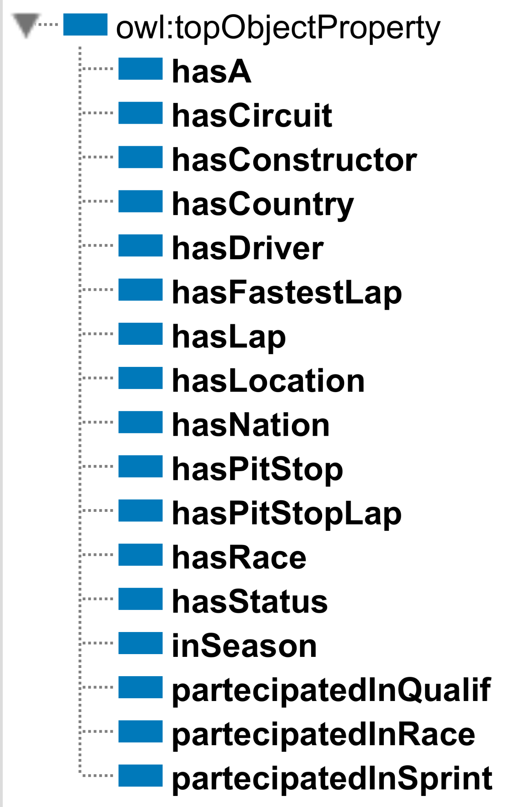
Ontology - Object properties
hasA (Race ↦ Qualifying or Sprint)
hasCircuit (Race ↦ Circuit)
hasConstructor (ConstructorStanding or Partecipation ↦ Constructor)
hasCountry (Location ↦ Country)
hasDriver (DriverStanding or Partecipation or Rating ↦ Driver)
hasFastestLap (RacePartecipation or SprintPartecipation ↦ Lap)
hasLap (RacePartecipation ↦ Lap)
hasLocation (Circuit ↦ Location)
hasNation (Constructor or Driver ↦ Country)
hasPitStop (RacePartecipation ↦ PitStop)
hasPitStopLap (PitStop ↦ Lap)
hasRace (Standing ↦ Race)
hasStatus (RacePartecipation or SprintPartecipation ↦ Status)
inSeason (Race or Rating ↦ Season)
partecipatedInQualif (QualifPartecipation ↦ Qualifying)
partecipatedInRace (RacePartecipation ↦ Race)
partecipatedInSprint (SprintPartecipation ↦ Sprint)

Slide 10
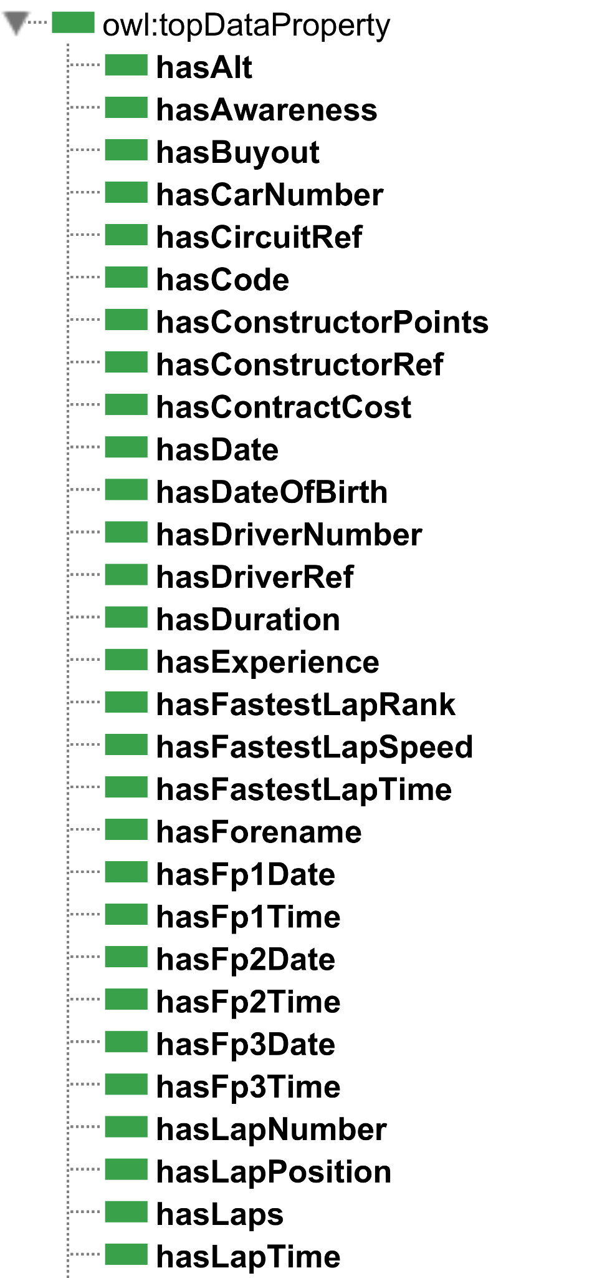
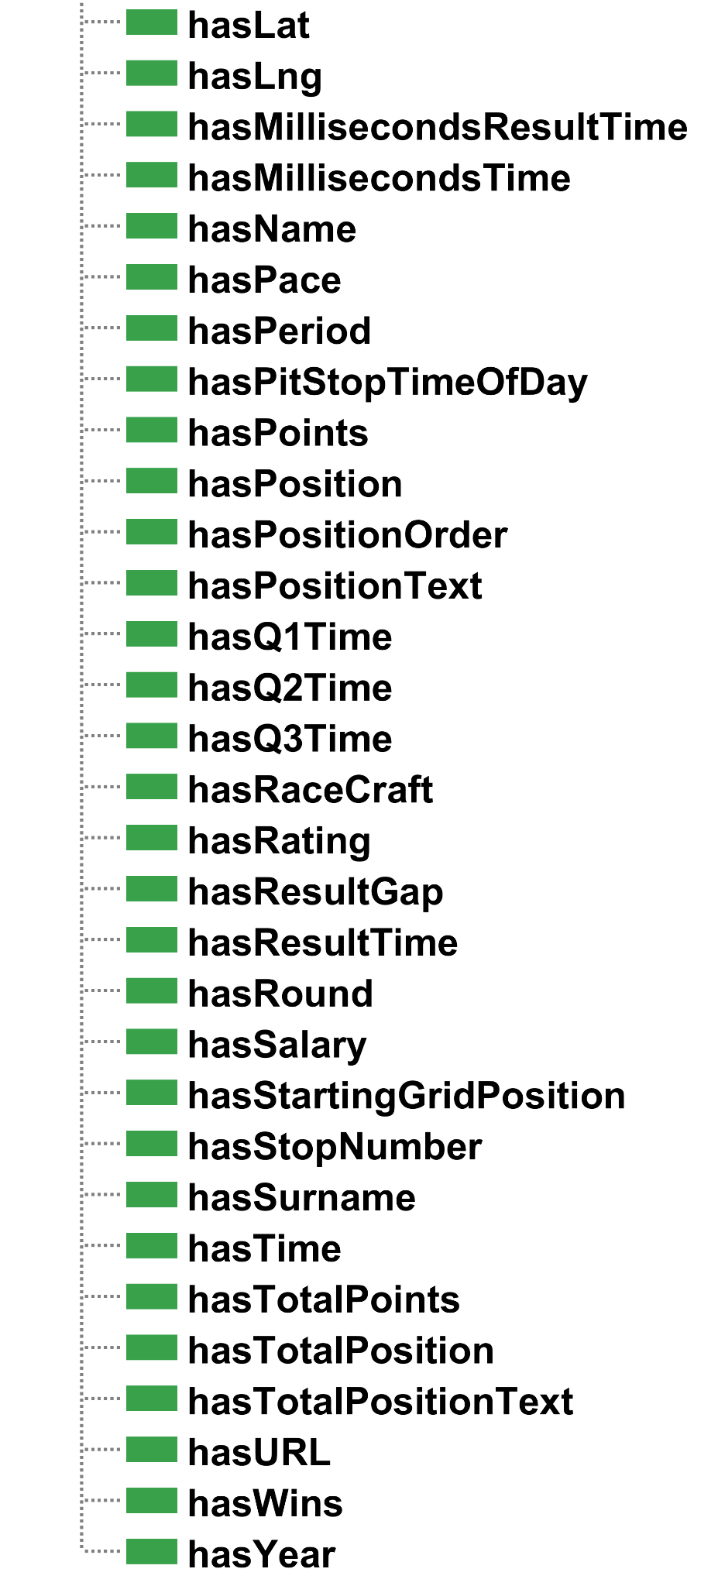
Ontology - Data properties

Slide 11
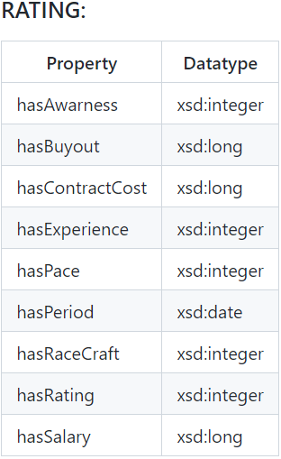
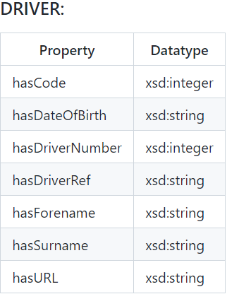
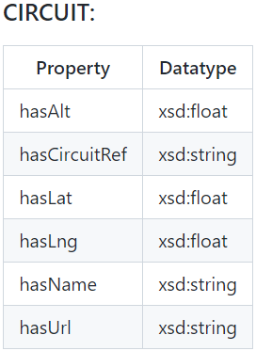
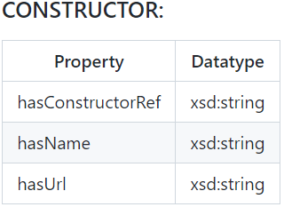
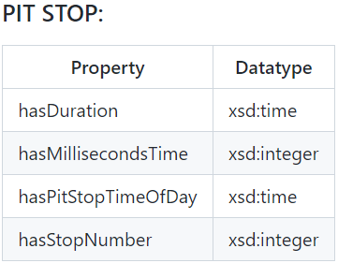
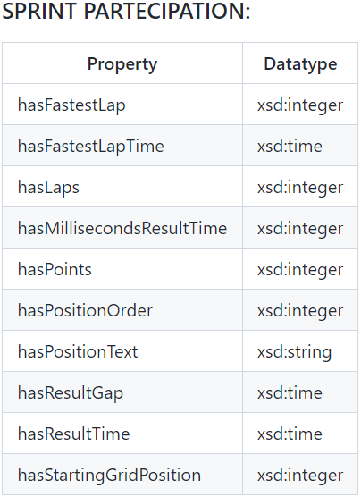
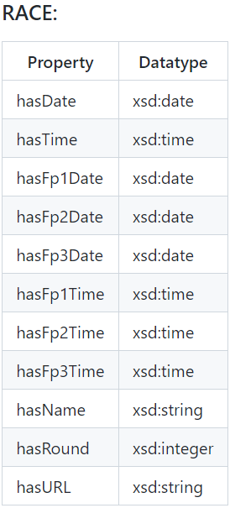
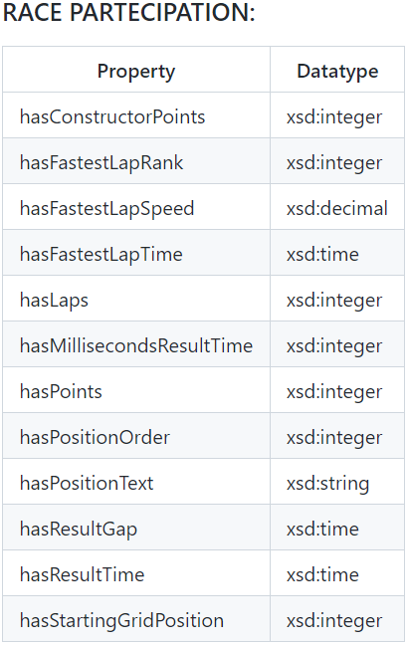
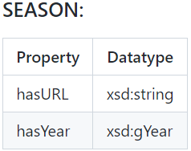
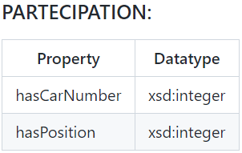
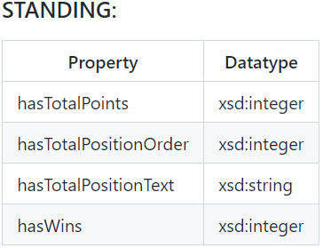
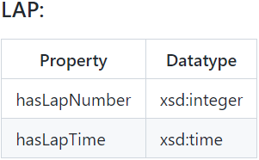
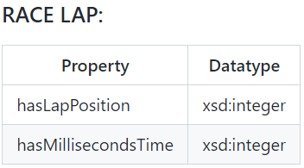
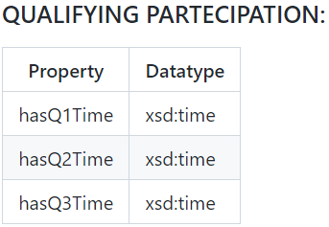
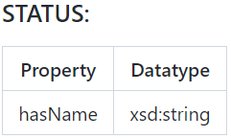
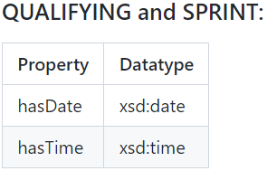
Ontology - Data properties

Slide 12
Serialization

Slide 13
Introduction
Serialization
Turtle files produced by the serialization process:
circuits.ttl | circuits.csv, countries.csv
constructors.ttl | constructors.csv, nationalities.csv
drivers.ttl | drivers.csv, nationalities.csv
laps1.ttl and laps2.ttl | lap_times.csv, results.csv, constructor_results.csv
qualifying.ttl | qualifying.csv, races.csv
race.ttl | races.csv
race_partecipation.ttl | results.csv, constructor_results.csv, lap_times.csv
ratings.ttl | ratings.csv, drivers.csv
sprint.ttl | sprint_results.csv, races.csv
standings.ttl | driver_standings.csv, constructor_standings.csv
status_season.ttl | status.csv, seasons.csv
stops.ttl | pit_stops.csv, results.csv, constructor_results.csv, lap_times.csv

Slide 14
Matching columns
Serialization
Left Join
We joined results.csv and constructor_results.csv in a single pandas dataframe. Then all the results of constructors (points) are matched with the driver result before managing the data frame.
Search
We searched the row in the original table by matching some constraints.

Slide 15
Nationality to country mapping
Serialization
We used this approach in drivers.ttl and constructors.ttl to maintain a single class country taken by an external source.
In this way, we avoided creating an additional nationality class.
Thus, it was not necessary to link each individual in the nationality class to the country class via an object property.
The mapping was done directly in the serialization step.

Slide 16
Queries

Slide 17
Final 2022 season driver's classification
Final 2022 season constructor's classification
PREFIX : <https://www.dei.unipd.it/db2/groupProject/FASTianF1#>
PREFIX xsd: <http://www.w3.org/2001/XMLSchema#>
SELECT ?name (MAX(?totPoints) AS ?finalPoints) WHERE {
?season :hasYear "2022"^^xsd:integer;
a :Season.
?race :inSeason ?season;
a :Race.
?drivStanding a :DriverStanding;
:hasTotalPoints ?totPoints;
:hasDriver ?driver;
:hasRace ?race.
?driver a :Driver;
:hasForename ?fname;
:hasSurname ?sname.
BIND(CONCAT(?fname, " ", ?sname) AS ?name).
}
GROUP BY (?name)
ORDER BY DESC (?finalPoints)
PREFIX : <https://www.dei.unipd.it/db2/groupProject/FASTianF1#>
PREFIX xsd: <http://www.w3.org/2001/XMLSchema#>
SELECT ?name (MAX(?totPoints) AS ?finalPoints) WHERE {
?season :hasYear "2022"^^xsd:integer;
a :Season.
?race :inSeason ?season;
a :Race.
?consStanding a :ConstructorStanding;
:hasTotalPoints ?totPoints;
:hasConstructor ?constructor;
:hasRace ?race.
?constructor :hasName ?name;
a :Constructor.
}
GROUP BY (?name)
ORDER BY DESC (?finalPoints)

Slide 18
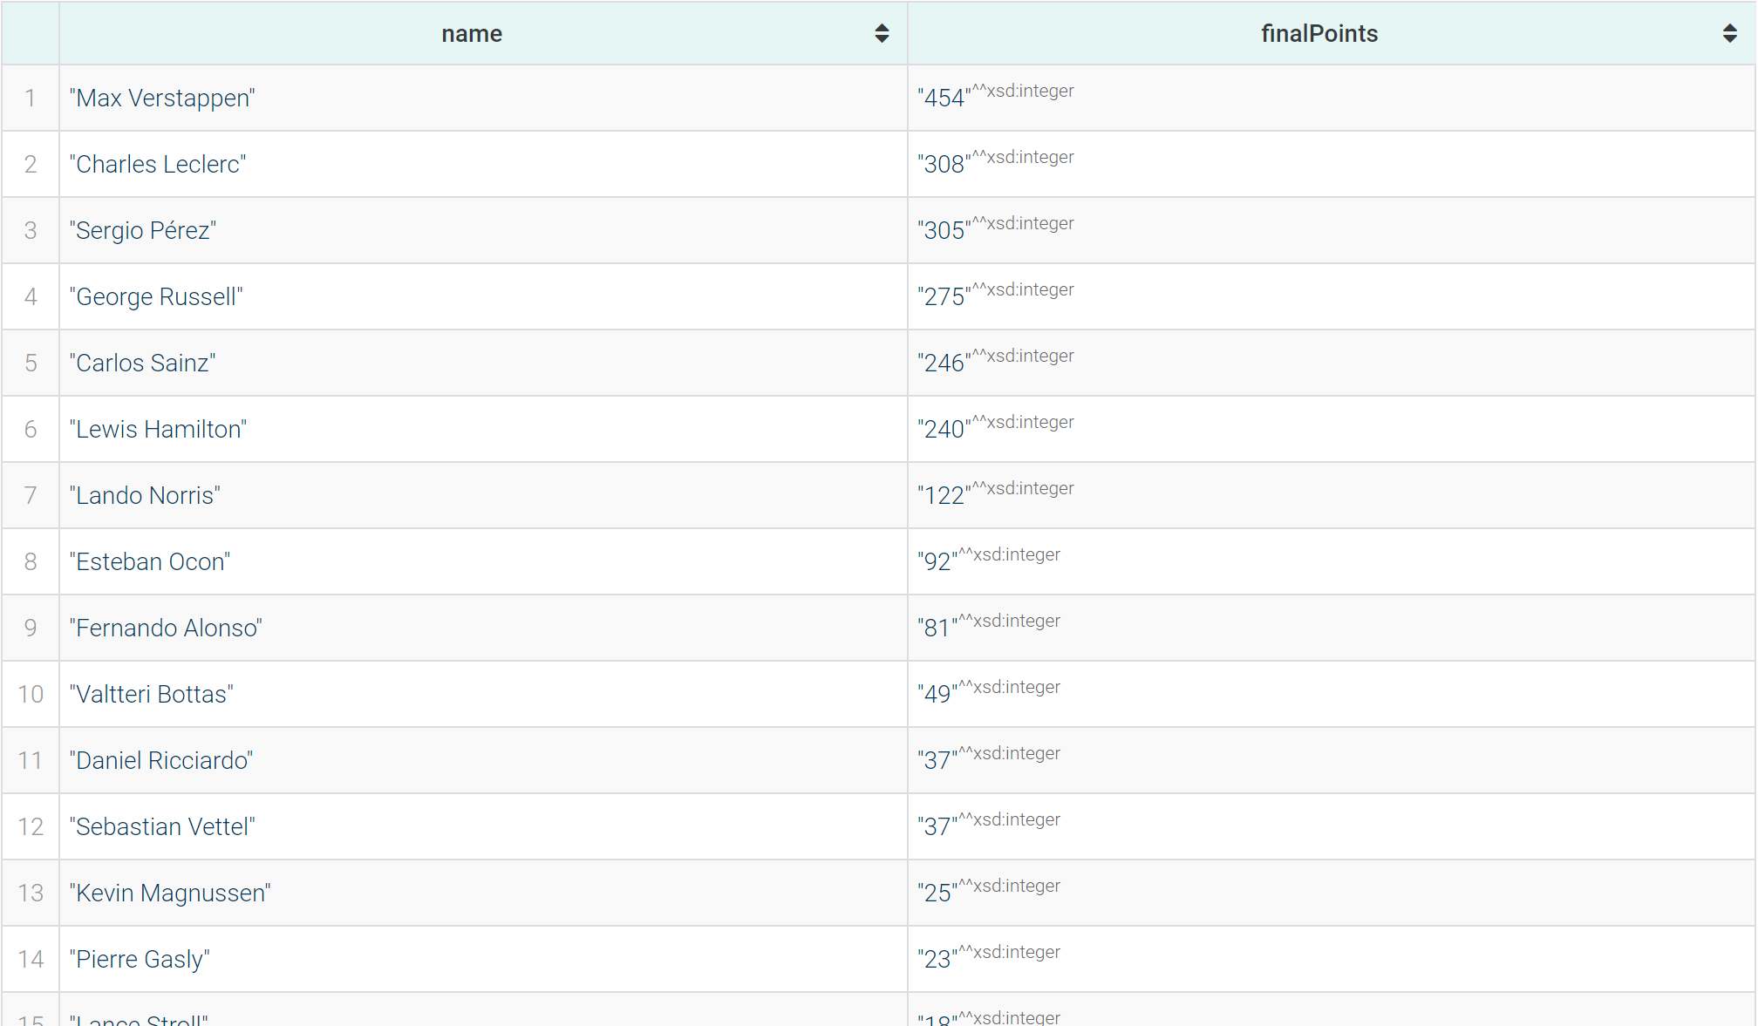
Final 2022 season driver's classification
Final 2022 season constructor's classification
PREFIX : <https://www.dei.unipd.it/db2/groupProject/FASTianF1#>
PREFIX xsd: <http://www.w3.org/2001/XMLSchema#>
SELECT ?name (MAX(?totPoints) AS ?finalPoints) WHERE {
?season :hasYear "2022"^^xsd:integer;
a :Season.
?race :inSeason ?season;
a :Race.
?drivStanding a :DriverStanding;
:hasTotalPoints ?totPoints;
:hasDriver ?driver;
:hasRace ?race.
?driver a :Driver;
:hasForename ?fname;
:hasSurname ?sname.
BIND(CONCAT(?fname, " ", ?sname) AS ?name).
}
GROUP BY (?name)
ORDER BY DESC (?finalPoints)
PREFIX : <https://www.dei.unipd.it/db2/groupProject/FASTianF1#>
PREFIX xsd: <http://www.w3.org/2001/XMLSchema#>
SELECT ?name (MAX(?totPoints) AS ?finalPoints) WHERE {
?season :hasYear "2022"^^xsd:integer;
a :Season.
?race :inSeason ?season;
a :Race.
?consStanding a :ConstructorStanding;
:hasTotalPoints ?totPoints;
:hasConstructor ?constructor;
:hasRace ?race.
?constructor :hasName ?name;
a :Constructor.
}
GROUP BY (?name)
ORDER BY DESC (?finalPoints)

Slide 19
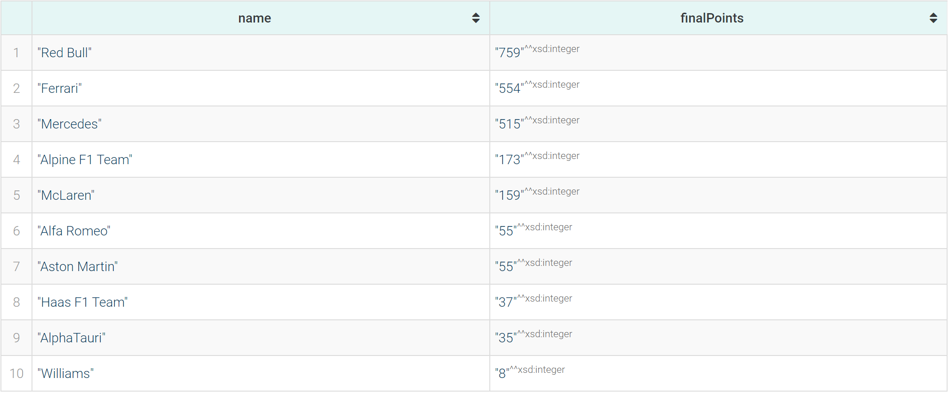
Final 2022 season driver's classification
Final 2022 season constructor's classification
PREFIX : <https://www.dei.unipd.it/db2/groupProject/FASTianF1#>
PREFIX xsd: <http://www.w3.org/2001/XMLSchema#>
SELECT ?name (MAX(?totPoints) AS ?finalPoints) WHERE {
?season :hasYear "2022"^^xsd:integer;
a :Season.
?race :inSeason ?season;
a :Race.
?drivStanding a :DriverStanding;
:hasTotalPoints ?totPoints;
:hasDriver ?driver;
:hasRace ?race.
?driver a :Driver;
:hasForename ?fname;
:hasSurname ?sname.
BIND(CONCAT(?fname, " ", ?sname) AS ?name).
}
GROUP BY (?name)
ORDER BY DESC (?finalPoints)
PREFIX : <https://www.dei.unipd.it/db2/groupProject/FASTianF1#>
PREFIX xsd: <http://www.w3.org/2001/XMLSchema#>
SELECT ?name (MAX(?totPoints) AS ?finalPoints) WHERE {
?season :hasYear "2022"^^xsd:integer;
a :Season.
?race :inSeason ?season;
a :Race.
?consStanding a :ConstructorStanding;
:hasTotalPoints ?totPoints;
:hasConstructor ?constructor;
:hasRace ?race.
?constructor :hasName ?name;
a :Constructor.
}
GROUP BY (?name)
ORDER BY DESC (?finalPoints)

Slide 20
Complete names of the 20 drivers with the most pit stops made with a single constructor
Most paid driver of 2023 season
PREFIX : <https://www.dei.unipd.it/db2/groupProject/FASTianF1#>
SELECT ?name (?cname AS ?constructorName) (SUM(?maxNumb) AS ?totalPitStops) WHERE{
{
SELECT ?partecipation ?name ?cname (MAX(?numb) AS ?maxNumb) WHERE {
?driver :hasForename ?fname ;
:hasSurname ?sname .
?partecipation :hasDriver ?driver ;
:hasPitStop ?stop ;
:hasConstructor ?constructor .
?constructor :hasName ?cname .
?stop :hasStopNumber ?numb .
BIND(CONCAT(?fname, " ", ?sname) AS ?name).
}
GROUP BY ?partecipation ?name ?cname
}
}
GROUP BY ?name ?cname
ORDER BY DESC(?totalPitStops)
LIMIT 20
PREFIX : <https://www.dei.unipd.it/db2/groupProject/FASTianF1#>
PREFIX xsd: <http://www.w3.org/2001/XMLSchema#>
SELECT ?name (MAX(?sal) as ?salary) WHERE {
?season :hasYear "2023"^^xsd:integer;
a :Season.
?rating :inSeason ?season;
:hasDriver ?driver;
:hasSalary ?sal;
a :Rating.
?driver a :Driver;
:hasForename ?fname;
:hasSurname ?sname.
BIND(CONCAT(?fname, " ", ?sname) AS ?name).
}
GROUP BY (?name)
ORDER BY DESC (?salary)

Slide 21
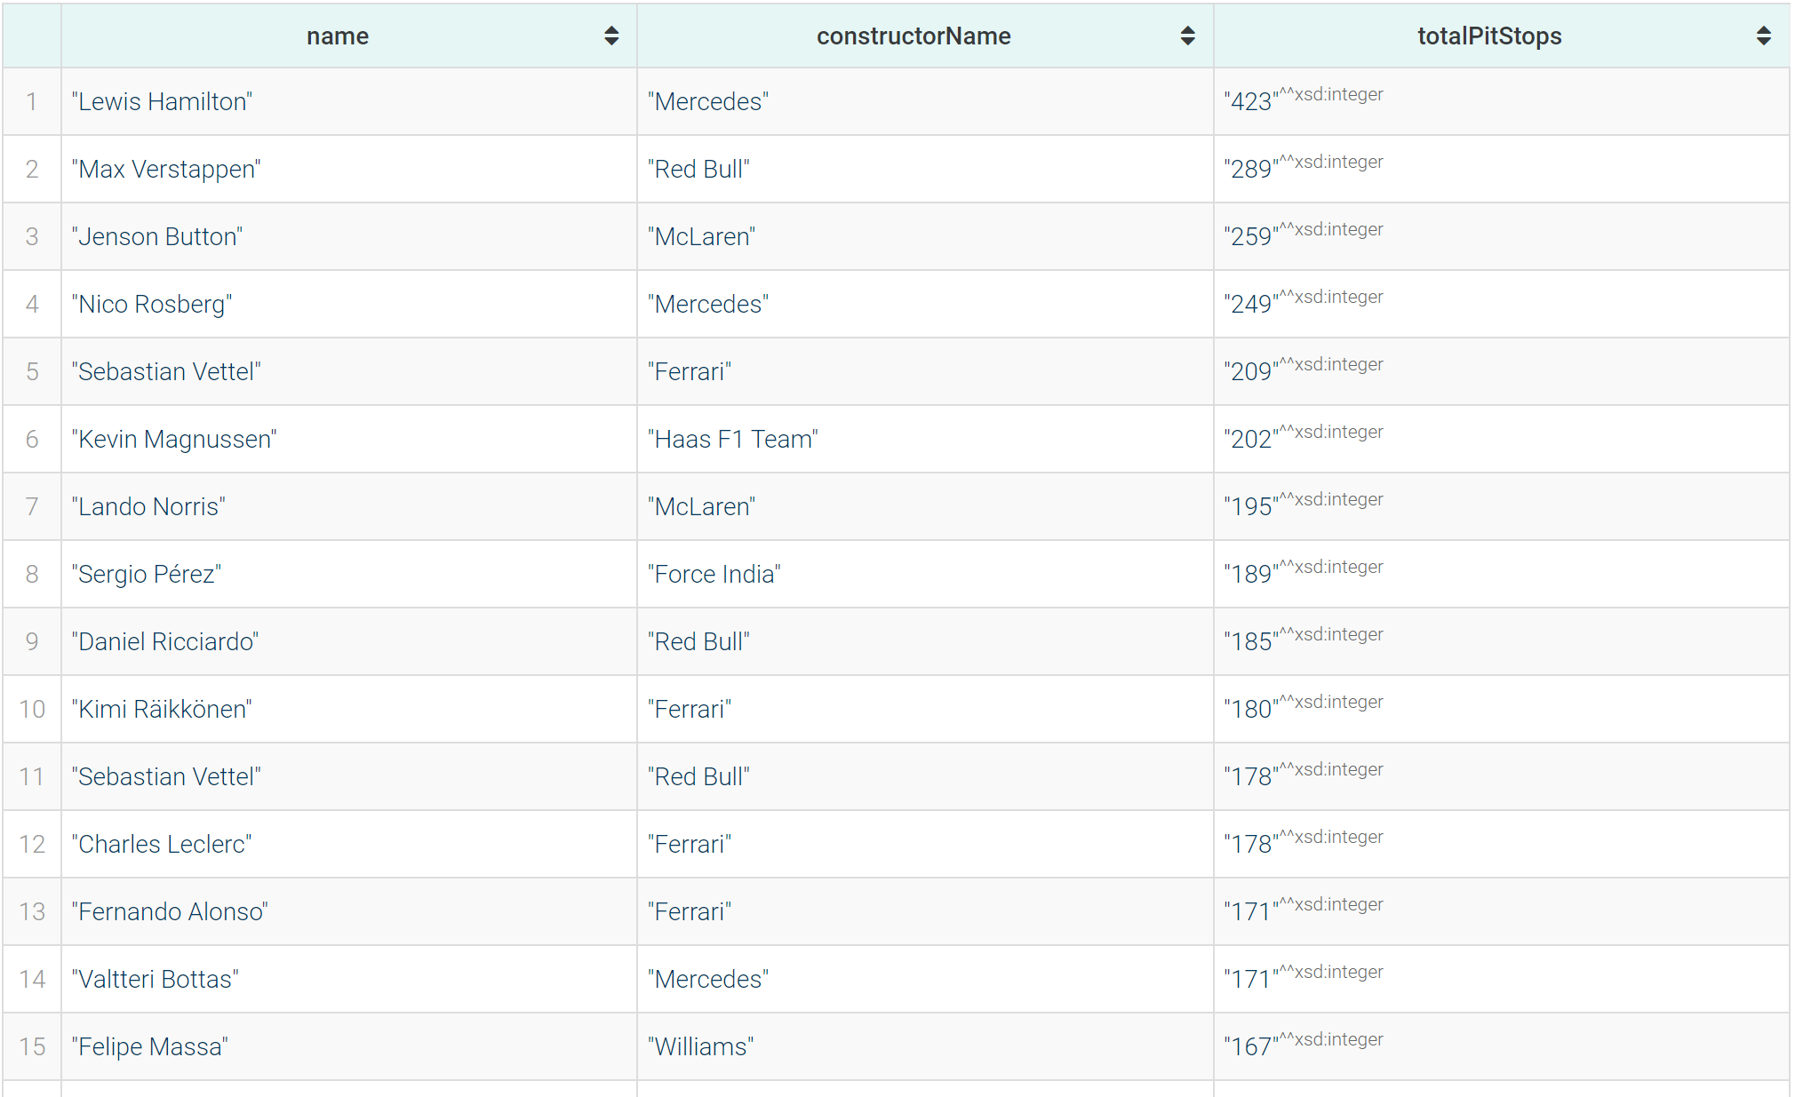
Complete names of the 20 drivers with the most pit stops made with a single constructor
Most paid driver of 2023 season
PREFIX : <https://www.dei.unipd.it/db2/groupProject/FASTianF1#>
SELECT ?name (?cname AS ?constructorName) (SUM(?maxNumb) AS ?totalPitStops) WHERE{
{
SELECT ?partecipation ?name ?cname (MAX(?numb) AS ?maxNumb) WHERE {
?driver :hasForename ?fname ;
:hasSurname ?sname .
?partecipation :hasDriver ?driver ;
:hasPitStop ?stop ;
:hasConstructor ?constructor .
?constructor :hasName ?cname .
?stop :hasStopNumber ?numb .
BIND(CONCAT(?fname, " ", ?sname) AS ?name).
}
GROUP BY ?partecipation ?name ?cname
}
}
GROUP BY ?name ?cname
ORDER BY DESC(?totalPitStops)
LIMIT 20
PREFIX : <https://www.dei.unipd.it/db2/groupProject/FASTianF1#>
PREFIX xsd: <http://www.w3.org/2001/XMLSchema#>
SELECT ?name (MAX(?sal) as ?salary) WHERE {
?season :hasYear "2023"^^xsd:integer;
a :Season.
?rating :inSeason ?season;
:hasDriver ?driver;
:hasSalary ?sal;
a :Rating.
?driver a :Driver;
:hasForename ?fname;
:hasSurname ?sname.
BIND(CONCAT(?fname, " ", ?sname) AS ?name).
}
GROUP BY (?name)
ORDER BY DESC (?salary)

Slide 22
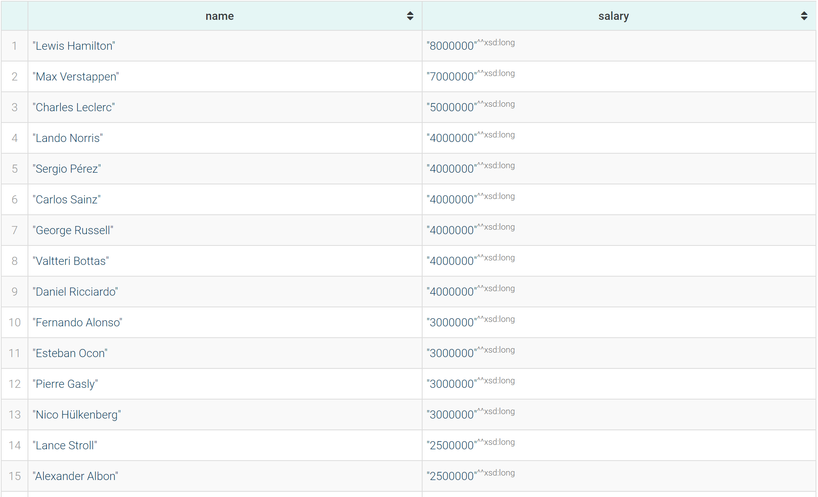
Complete names of the 20 drivers with the most pit stops made with a single constructor
Most paid driver of 2023 season
PREFIX : <https://www.dei.unipd.it/db2/groupProject/FASTianF1#>
SELECT ?name (?cname AS ?constructorName) (SUM(?maxNumb) AS ?totalPitStops) WHERE{
{
SELECT ?partecipation ?name ?cname (MAX(?numb) AS ?maxNumb) WHERE {
?driver :hasForename ?fname ;
:hasSurname ?sname .
?partecipation :hasDriver ?driver ;
:hasPitStop ?stop ;
:hasConstructor ?constructor .
?constructor :hasName ?cname .
?stop :hasStopNumber ?numb .
BIND(CONCAT(?fname, " ", ?sname) AS ?name).
}
GROUP BY ?partecipation ?name ?cname
}
}
GROUP BY ?name ?cname
ORDER BY DESC(?totalPitStops)
LIMIT 20
PREFIX : <https://www.dei.unipd.it/db2/groupProject/FASTianF1#>
PREFIX xsd: <http://www.w3.org/2001/XMLSchema#>
SELECT ?name (MAX(?sal) as ?salary) WHERE {
?season :hasYear "2023"^^xsd:integer;
a :Season.
?rating :inSeason ?season;
:hasDriver ?driver;
:hasSalary ?sal;
a :Rating.
?driver a :Driver;
:hasForename ?fname;
:hasSurname ?sname.
BIND(CONCAT(?fname, " ", ?sname) AS ?name).
}
GROUP BY (?name)
ORDER BY DESC (?salary)

Slide 23
All the italian drivers who won an italian grand prix, driving an italian car, ordered by number of wins
The most winning italian driver in F1 history
PREFIX : <https://www.dei.unipd.it/db2/groupProject/FASTianF1#>
PREFIX xsd: <http://www.w3.org/2001/XMLSchema#>
PREFIX countries: <http://eulersharp.sourceforge.net/2003/03swap/countries#>
SELECT ?name (COUNT(?name) as ?numOfWins) WHERE {
?race :hasCircuit ?circuit;
a :Race.
?racePart :partecipatedInRace ?race;
:hasPositionOrder "1"^^xsd:integer;
:hasDriver ?driver.
?driver a :Driver;
:hasNation countries:it;
:hasForename ?fname;
:hasSurname ?sname.
BIND(CONCAT(?fname, " ", ?sname) AS ?name).
} GROUP BY ?name
ORDER BY DESC (?numOfWins)
LIMIT 1
PREFIX : <https://www.dei.unipd.it/db2/groupProject/FASTianF1#>
PREFIX xsd: <http://www.w3.org/2001/XMLSchema#>
PREFIX countries: <http://eulersharp.sourceforge.net/2003/03swap/countries#>
SELECT ?name (COUNT(?name) as ?numOfWins) ?consName WHERE {
?race :hasCircuit ?circuit;
a :Race.
?circuit :hasLocation ?location;
a :Circuit.
?location :hasCountry countries:it;
a :Location.
?racePart :partecipatedInRace ?race;
:hasPositionOrder "1"^^xsd:integer;
:hasConstructor ?constructor;
:hasDriver ?driver.
?constructor a :Constructor;
:hasName ?consName;
:hasNation countries:it.
?driver a :Driver;
:hasNation countries:it;
:hasForename ?fname;
:hasSurname ?sname.
BIND(CONCAT(?fname, " ", ?sname) AS ?name).
} GROUP BY ?name ?consName
ORDER BY DESC (?numOfWins)

Slide 24
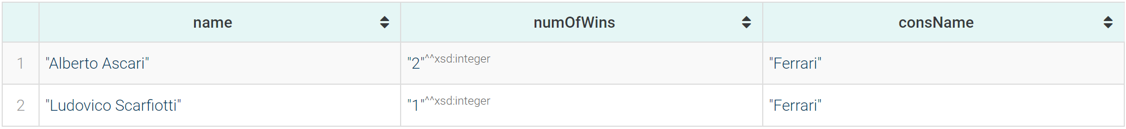
All the italian drivers who won an italian grand prix, driving an italian car, ordered by number of wins
The most winning italian driver in F1 history
PREFIX : <https://www.dei.unipd.it/db2/groupProject/FASTianF1#>
PREFIX xsd: <http://www.w3.org/2001/XMLSchema#>
PREFIX countries: <http://eulersharp.sourceforge.net/2003/03swap/countries#>
SELECT ?name (COUNT(?name) as ?numOfWins) WHERE {
?race :hasCircuit ?circuit;
a :Race.
?racePart :partecipatedInRace ?race;
:hasPositionOrder "1"^^xsd:integer;
:hasDriver ?driver.
?driver a :Driver;
:hasNation countries:it;
:hasForename ?fname;
:hasSurname ?sname.
BIND(CONCAT(?fname, " ", ?sname) AS ?name).
} GROUP BY ?name
ORDER BY DESC (?numOfWins)
LIMIT 1
PREFIX : <https://www.dei.unipd.it/db2/groupProject/FASTianF1#>
PREFIX xsd: <http://www.w3.org/2001/XMLSchema#>
PREFIX countries: <http://eulersharp.sourceforge.net/2003/03swap/countries#>
SELECT ?name (COUNT(?name) as ?numOfWins) ?consName WHERE {
?race :hasCircuit ?circuit;
a :Race.
?circuit :hasLocation ?location;
a :Circuit.
?location :hasCountry countries:it;
a :Location.
?racePart :partecipatedInRace ?race;
:hasPositionOrder "1"^^xsd:integer;
:hasConstructor ?constructor;
:hasDriver ?driver.
?constructor a :Constructor;
:hasName ?consName;
:hasNation countries:it.
?driver a :Driver;
:hasNation countries:it;
:hasForename ?fname;
:hasSurname ?sname.
BIND(CONCAT(?fname, " ", ?sname) AS ?name).
} GROUP BY ?name ?consName
ORDER BY DESC (?numOfWins)

Slide 25
All the italian drivers who won an italian grand prix, driving an italian car, ordered by number of wins
The most winning italian driver in F1 history
PREFIX : <https://www.dei.unipd.it/db2/groupProject/FASTianF1#>
PREFIX xsd: <http://www.w3.org/2001/XMLSchema#>
PREFIX countries: <http://eulersharp.sourceforge.net/2003/03swap/countries#>
SELECT ?name (COUNT(?name) as ?numOfWins) WHERE {
?race :hasCircuit ?circuit;
a :Race.
?racePart :partecipatedInRace ?race;
:hasPositionOrder "1"^^xsd:integer;
:hasDriver ?driver.
?driver a :Driver;
:hasNation countries:it;
:hasForename ?fname;
:hasSurname ?sname.
BIND(CONCAT(?fname, " ", ?sname) AS ?name).
} GROUP BY ?name
ORDER BY DESC (?numOfWins)
LIMIT 1
PREFIX : <https://www.dei.unipd.it/db2/groupProject/FASTianF1#>
PREFIX xsd: <http://www.w3.org/2001/XMLSchema#>
PREFIX countries: <http://eulersharp.sourceforge.net/2003/03swap/countries#>
SELECT ?name (COUNT(?name) as ?numOfWins) ?consName WHERE {
?race :hasCircuit ?circuit;
a :Race.
?circuit :hasLocation ?location;
a :Circuit.
?location :hasCountry countries:it;
a :Location.
?racePart :partecipatedInRace ?race;
:hasPositionOrder "1"^^xsd:integer;
:hasConstructor ?constructor;
:hasDriver ?driver.
?constructor a :Constructor;
:hasName ?consName;
:hasNation countries:it.
?driver a :Driver;
:hasNation countries:it;
:hasForename ?fname;
:hasSurname ?sname.
BIND(CONCAT(?fname, " ", ?sname) AS ?name).
} GROUP BY ?name ?consName
ORDER BY DESC (?numOfWins)

Slide 26
The 5 most winning drivers in F1 history, ordered by number of grand prix wins
Information regarding the youngest drivers who have won races, in order of age
PREFIX : <https://www.dei.unipd.it/db2/groupProject/FASTianF1#>
PREFIX xsd: <http://www.w3.org/2001/XMLSchema#>
SELECT ?fullName ?age (COUNT(?pos) AS ?wins) (GROUP_CONCAT(DISTINCT YEAR(?raceDate) ; separator=",") AS ?year) (GROUP_CONCAT(DISTINCT ?circName ; separator=",") AS ?circuitNames) WHERE{
?part :hasDriver ?driver ;
:hasPosition ?pos ;
:partecipatedInRace ?race .
?race :hasDate ?raceDate ;
:hasCircuit ?circ .
?circ :hasName ?circName .
?driver :hasDateOfBirth ?dob ;
:hasForename ?fname ;
:hasSurname ?lname .
BIND(CONCAT(?fname, " ", ?lname) AS ?fullName)
BIND((YEAR(?raceDate) - YEAR(?dob)) AS ?age)
FILTER(?pos = 1 && ?age < 26)
}
GROUP BY ?fullName ?age
ORDER BY ASC (?age)
PREFIX : <https://www.dei.unipd.it/db2/groupProject/FASTianF1#>
PREFIX xsd: <http://www.w3.org/2001/XMLSchema#>
SELECT ?name (COUNT(?name) as ?numOfWins) WHERE {
?race :hasCircuit ?circuit;
a :Race.
?racePart :partecipatedInRace ?race;
:hasPositionOrder "1"^^xsd:integer;
:hasDriver ?driver.
?driver a :Driver;
:hasForename ?fname;
:hasSurname ?sname.
BIND(CONCAT(?fname, " ", ?sname) AS ?name).
} GROUP BY ?name
ORDER BY DESC (?numOfWins)
LIMIT 5

Slide 27
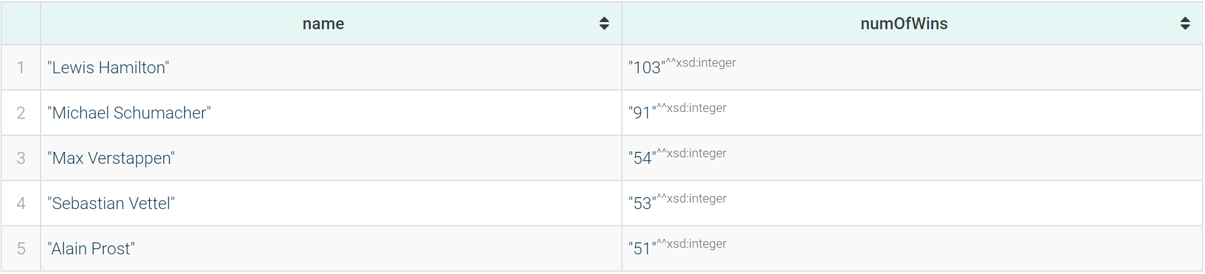
The 5 most winning drivers in F1 history, ordered by number of grand prix wins
Information regarding the youngest drivers who have won races, in order of age
PREFIX : <https://www.dei.unipd.it/db2/groupProject/FASTianF1#>
PREFIX xsd: <http://www.w3.org/2001/XMLSchema#>
SELECT ?fullName ?age (COUNT(?pos) AS ?wins) (GROUP_CONCAT(DISTINCT YEAR(?raceDate) ; separator=",") AS ?year) (GROUP_CONCAT(DISTINCT ?circName ; separator=",") AS ?circuitNames) WHERE{
?part :hasDriver ?driver ;
:hasPosition ?pos ;
:partecipatedInRace ?race .
?race :hasDate ?raceDate ;
:hasCircuit ?circ .
?circ :hasName ?circName .
?driver :hasDateOfBirth ?dob ;
:hasForename ?fname ;
:hasSurname ?lname .
BIND(CONCAT(?fname, " ", ?lname) AS ?fullName)
BIND((YEAR(?raceDate) - YEAR(?dob)) AS ?age)
FILTER(?pos = 1 && ?age < 26)
}
GROUP BY ?fullName ?age
ORDER BY ASC (?age)
PREFIX : <https://www.dei.unipd.it/db2/groupProject/FASTianF1#>
PREFIX xsd: <http://www.w3.org/2001/XMLSchema#>
SELECT ?name (COUNT(?name) as ?numOfWins) WHERE {
?race :hasCircuit ?circuit;
a :Race.
?racePart :partecipatedInRace ?race;
:hasPositionOrder "1"^^xsd:integer;
:hasDriver ?driver.
?driver a :Driver;
:hasForename ?fname;
:hasSurname ?sname.
BIND(CONCAT(?fname, " ", ?sname) AS ?name).
} GROUP BY ?name
ORDER BY DESC (?numOfWins)
LIMIT 5

Slide 28
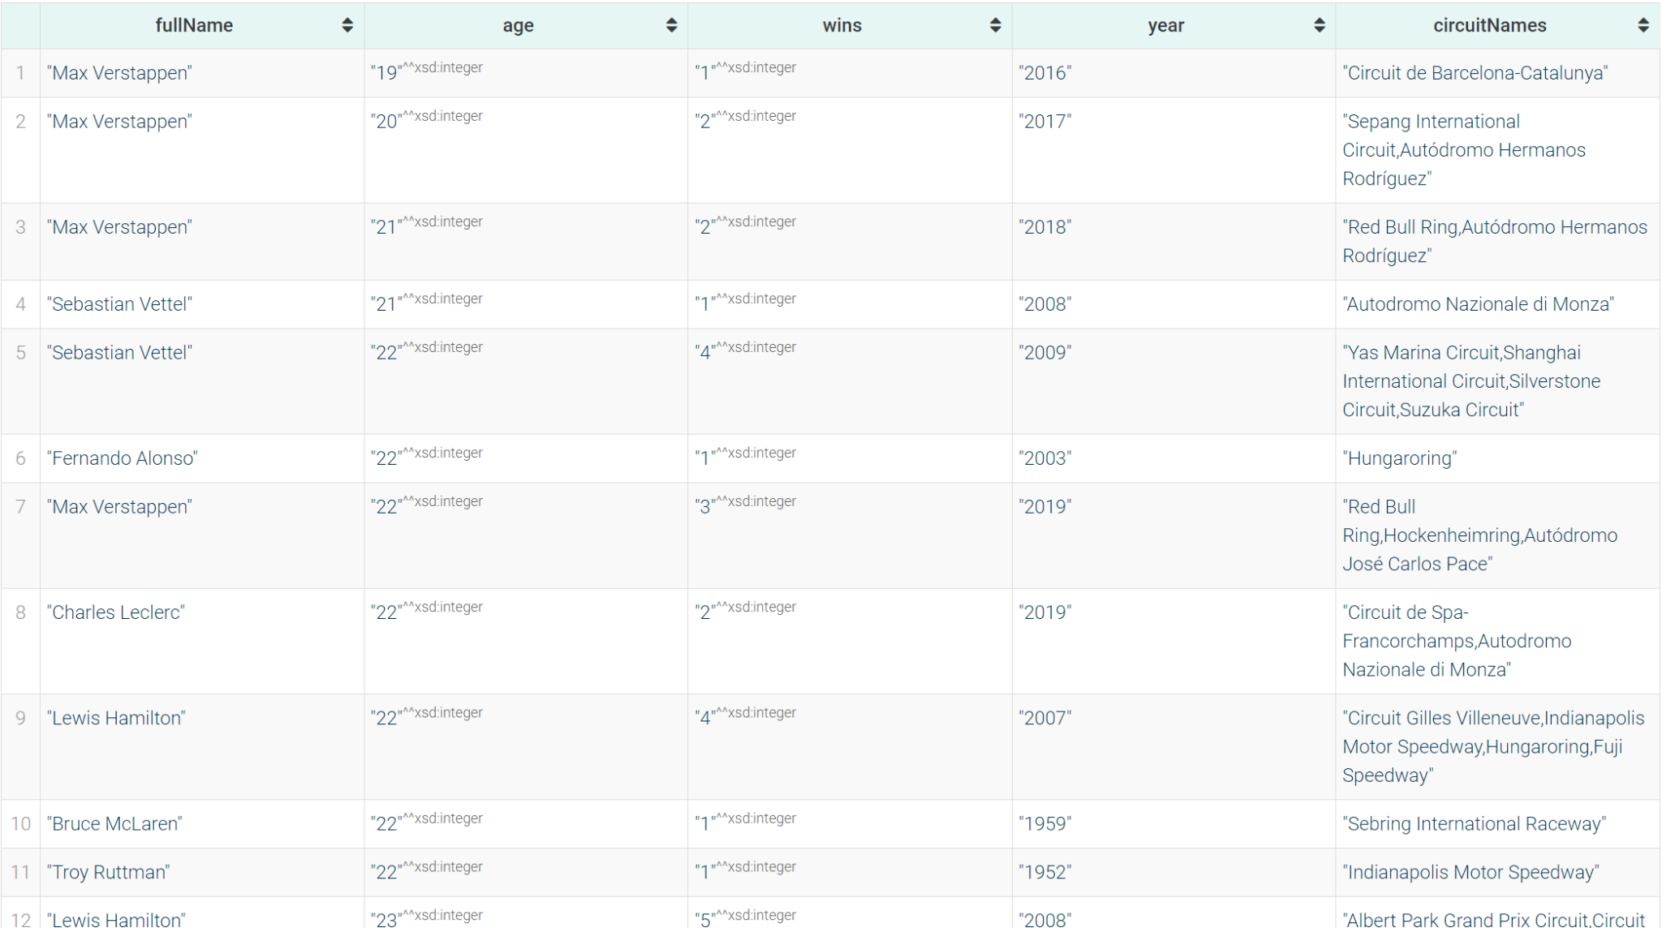
The 5 most winning drivers in F1 history, ordered by number of grand prix wins
Information regarding the youngest drivers who have won races, in order of age
PREFIX : <https://www.dei.unipd.it/db2/groupProject/FASTianF1#>
PREFIX xsd: <http://www.w3.org/2001/XMLSchema#>
SELECT ?fullName ?age (COUNT(?pos) AS ?wins) (GROUP_CONCAT(DISTINCT YEAR(?raceDate) ; separator=",") AS ?year) (GROUP_CONCAT(DISTINCT ?circName ; separator=",") AS ?circuitNames) WHERE{
?part :hasDriver ?driver ;
:hasPosition ?pos ;
:partecipatedInRace ?race .
?race :hasDate ?raceDate ;
:hasCircuit ?circ .
?circ :hasName ?circName .
?driver :hasDateOfBirth ?dob ;
:hasForename ?fname ;
:hasSurname ?lname .
BIND(CONCAT(?fname, " ", ?lname) AS ?fullName)
BIND((YEAR(?raceDate) - YEAR(?dob)) AS ?age)
FILTER(?pos = 1 && ?age < 26)
}
GROUP BY ?fullName ?age
ORDER BY ASC (?age)
PREFIX : <https://www.dei.unipd.it/db2/groupProject/FASTianF1#>
PREFIX xsd: <http://www.w3.org/2001/XMLSchema#>
SELECT ?name (COUNT(?name) as ?numOfWins) WHERE {
?race :hasCircuit ?circuit;
a :Race.
?racePart :partecipatedInRace ?race;
:hasPositionOrder "1"^^xsd:integer;
:hasDriver ?driver.
?driver a :Driver;
:hasForename ?fname;
:hasSurname ?sname.
BIND(CONCAT(?fname, " ", ?sname) AS ?name).
} GROUP BY ?name
ORDER BY DESC (?numOfWins)
LIMIT 5

Slide 29
Data about fastest qualifying laps in F1 history (both q1, q2 and q3)
PREFIX : <https://www.dei.unipd.it/db2/groupProject/FASTianF1#>
PREFIX xsd: <http://www.w3.org/2001/XMLSchema#>
SELECT ?driversName ?qTime ?circuitName ?raceName WHERE {
{
?qualPart :hasQ3Time ?qTime.
}
UNION
{
?qualPart :hasQ2Time ?qTime.
}
UNION
{
?qualPart :hasQ1Time ?qTime.
}
?qualPart :hasDriver ?driver;
:partecipatedInQualif ?quali;
a :QualifPartecipation.
?quali a :Qualifying.
?race a :Race;
:hasA ?quali;
:hasName ?raceName;
:hasCircuit ?circ.
?circ a :Circuit;
:hasName ?circuitName.
?driver a :Driver;
:hasForename ?fname;
:hasSurname ?sname.
BIND(CONCAT(?fname, " ", ?sname) AS ?driversName).
FILTER(?qTime != "00:00:00"^^xsd:time)
}
ORDER BY (?qTime)
LIMIT 100

Slide 30
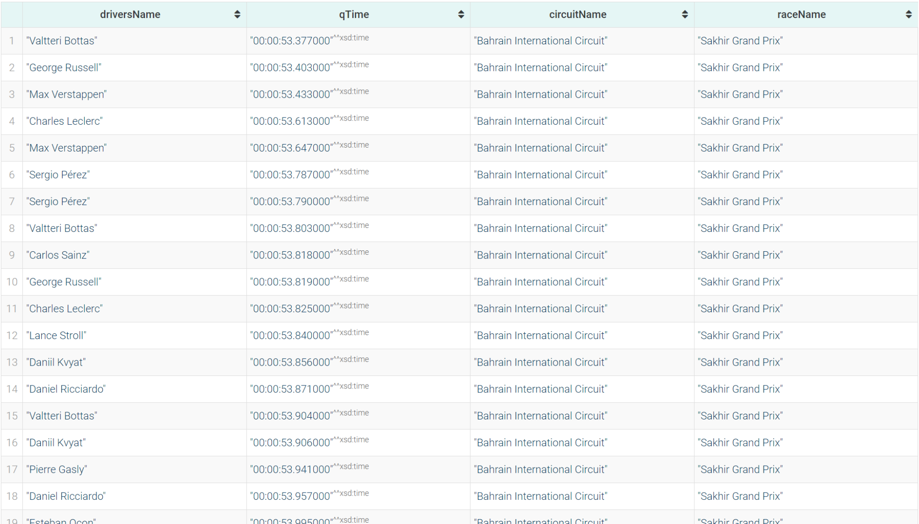
Data about fastest qualifying laps in F1 history (both q1, q2 and q3)
PREFIX : <https://www.dei.unipd.it/db2/groupProject/FASTianF1#>
PREFIX xsd: <http://www.w3.org/2001/XMLSchema#>
SELECT ?driversName ?qTime ?circuitName ?raceName WHERE {
{
?qualPart :hasQ3Time ?qTime.
}
UNION
{
?qualPart :hasQ2Time ?qTime.
}
UNION
{
?qualPart :hasQ1Time ?qTime.
}
?qualPart :hasDriver ?driver;
:partecipatedInQualif ?quali;
a :QualifPartecipation.
?quali a :Qualifying.
?race a :Race;
:hasA ?quali;
:hasName ?raceName;
:hasCircuit ?circ.
?circ a :Circuit;
:hasName ?circuitName.
?driver a :Driver;
:hasForename ?fname;
:hasSurname ?sname.
BIND(CONCAT(?fname, " ", ?sname) AS ?driversName).
FILTER(?qTime != "00:00:00"^^xsd:time)
}
ORDER BY (?qTime)
LIMIT 100

Slide 31
Name of the F1 driver with the highest number of pole position achieved
Name of the F1 driver with the highest number of pole position achieved, counted as number of times his starting grid position was 1. Also, printed the qualifying result in those races, to see if qualifying result is pole position or not (for penalties or other stuff)
PREFIX : <https://www.dei.unipd.it/db2/groupProject/FASTianF1#>
PREFIX xsd: <http://www.w3.org/2001/XMLSchema#>
SELECT ?driversName (COUNT(?driversName) as ?numOfPoles) WHERE {
?qualiPart a :QualifPartecipation;
:hasPosition "1"^^xsd:integer;
:hasDriver ?driver.
?driver a :Driver;
:hasForename ?fname;
:hasSurname ?sname.
BIND(CONCAT(?fname, " ", ?sname) AS ?driversName).
}
GROUP BY (?driversName)
ORDER BY DESC (?numOfPoles)
LIMIT 1
PREFIX : <https://www.dei.unipd.it/db2/groupProject/FASTianF1#>
PREFIX xsd: <http://www.w3.org/2001/XMLSchema#>
SELECT ?driversName (COUNT(?driversName) as ?numOfPoles) (GROUP_CONCAT((?qualiPos) ; separator=",") AS ?qualifPositions) WHERE {
?racePart a :RacePartecipation;
:partecipatedInRace ?race;
:hasStartingGridPosition "1"^^xsd:integer;
:hasDriver ?driver.
?race a :Race.
?driver a :Driver;
:hasForename ?fname;
:hasSurname ?sname.
BIND(CONCAT(?fname, " ", ?sname) AS ?driversName).
OPTIONAL{
?race :hasA ?qual.
?qual a :Qualifying.
?qualiPart a :QualifPartecipation;
:partecipatedInQualif ?qual;
:hasDriver ?driver;
:hasPosition ?qualiPos.
}.
}
GROUP BY ?driversName
ORDER BY DESC (?numOfPoles)
LIMIT 1
Date of the first qualifying in the dataset
PREFIX : <https://www.dei.unipd.it/db2/groupProject/FASTianF1#>
PREFIX xsd: <http://www.w3.org/2001/XMLSchema#>
SELECT ?date WHERE {
?qualiPart a :QualifPartecipation;
:partecipatedInQualif ?quali.
?quali a :Qualifying.
?race a :Race;
:hasA ?quali;
:hasDate ?date.
}
ORDER BY (?date)
LIMIT 1

Slide 32
Name of the F1 driver with the highest number of pole position achieved
Name of the F1 driver with the highest number of pole position achieved, counted as number of times his starting grid position was 1. Also, printed the qualifying result in those races, to see if qualifying result is pole position or not (for penalties or other stuff)
PREFIX : <https://www.dei.unipd.it/db2/groupProject/FASTianF1#>
PREFIX xsd: <http://www.w3.org/2001/XMLSchema#>
SELECT ?driversName (COUNT(?driversName) as ?numOfPoles) WHERE {
?qualiPart a :QualifPartecipation;
:hasPosition "1"^^xsd:integer;
:hasDriver ?driver.
?driver a :Driver;
:hasForename ?fname;
:hasSurname ?sname.
BIND(CONCAT(?fname, " ", ?sname) AS ?driversName).
}
GROUP BY (?driversName)
ORDER BY DESC (?numOfPoles)
LIMIT 1
PREFIX : <https://www.dei.unipd.it/db2/groupProject/FASTianF1#>
PREFIX xsd: <http://www.w3.org/2001/XMLSchema#>
SELECT ?driversName (COUNT(?driversName) as ?numOfPoles) (GROUP_CONCAT((?qualiPos) ; separator=",") AS ?qualifPositions) WHERE {
?racePart a :RacePartecipation;
:partecipatedInRace ?race;
:hasStartingGridPosition "1"^^xsd:integer;
:hasDriver ?driver.
?race a :Race.
?driver a :Driver;
:hasForename ?fname;
:hasSurname ?sname.
BIND(CONCAT(?fname, " ", ?sname) AS ?driversName).
OPTIONAL{
?race :hasA ?qual.
?qual a :Qualifying.
?qualiPart a :QualifPartecipation;
:partecipatedInQualif ?qual;
:hasDriver ?driver;
:hasPosition ?qualiPos.
}.
}
GROUP BY ?driversName
ORDER BY DESC (?numOfPoles)
LIMIT 1
Date of the first qualifying in the dataset
PREFIX : <https://www.dei.unipd.it/db2/groupProject/FASTianF1#>
PREFIX xsd: <http://www.w3.org/2001/XMLSchema#>
SELECT ?date WHERE {
?qualiPart a :QualifPartecipation;
:partecipatedInQualif ?quali.
?quali a :Qualifying.
?race a :Race;
:hasA ?quali;
:hasDate ?date.
}
ORDER BY (?date)
LIMIT 1

Slide 33
Name of the F1 driver with the highest number of pole position achieved
Name of the F1 driver with the highest number of pole position achieved, counted as number of times his starting grid position was 1. Also, printed the qualifying result in those races, to see if qualifying result is pole position or not (for penalties or other stuff)
PREFIX : <https://www.dei.unipd.it/db2/groupProject/FASTianF1#>
PREFIX xsd: <http://www.w3.org/2001/XMLSchema#>
SELECT ?driversName (COUNT(?driversName) as ?numOfPoles) WHERE {
?qualiPart a :QualifPartecipation;
:hasPosition "1"^^xsd:integer;
:hasDriver ?driver.
?driver a :Driver;
:hasForename ?fname;
:hasSurname ?sname.
BIND(CONCAT(?fname, " ", ?sname) AS ?driversName).
}
GROUP BY (?driversName)
ORDER BY DESC (?numOfPoles)
LIMIT 1
PREFIX : <https://www.dei.unipd.it/db2/groupProject/FASTianF1#>
PREFIX xsd: <http://www.w3.org/2001/XMLSchema#>
SELECT ?driversName (COUNT(?driversName) as ?numOfPoles) (GROUP_CONCAT((?qualiPos) ; separator=",") AS ?qualifPositions) WHERE {
?racePart a :RacePartecipation;
:partecipatedInRace ?race;
:hasStartingGridPosition "1"^^xsd:integer;
:hasDriver ?driver.
?race a :Race.
?driver a :Driver;
:hasForename ?fname;
:hasSurname ?sname.
BIND(CONCAT(?fname, " ", ?sname) AS ?driversName).
OPTIONAL{
?race :hasA ?qual.
?qual a :Qualifying.
?qualiPart a :QualifPartecipation;
:partecipatedInQualif ?qual;
:hasDriver ?driver;
:hasPosition ?qualiPos.
}.
}
GROUP BY ?driversName
ORDER BY DESC (?numOfPoles)
LIMIT 1
Date of the first qualifying in the dataset
PREFIX : <https://www.dei.unipd.it/db2/groupProject/FASTianF1#>
PREFIX xsd: <http://www.w3.org/2001/XMLSchema#>
SELECT ?date WHERE {
?qualiPart a :QualifPartecipation;
:partecipatedInQualif ?quali.
?quali a :Qualifying.
?race a :Race;
:hasA ?quali;
:hasDate ?date.
}
ORDER BY (?date)
LIMIT 1

Slide 34
Name of the F1 driver with the highest number of pole position achieved
Name of the F1 driver with the highest number of pole position achieved, counted as number of times his starting grid position was 1. Also, printed the qualifying result in those races, to see if qualifying result is pole position or not (for penalties or other stuff)
PREFIX : <https://www.dei.unipd.it/db2/groupProject/FASTianF1#>
PREFIX xsd: <http://www.w3.org/2001/XMLSchema#>
SELECT ?driversName (COUNT(?driversName) as ?numOfPoles) WHERE {
?qualiPart a :QualifPartecipation;
:hasPosition "1"^^xsd:integer;
:hasDriver ?driver.
?driver a :Driver;
:hasForename ?fname;
:hasSurname ?sname.
BIND(CONCAT(?fname, " ", ?sname) AS ?driversName).
}
GROUP BY (?driversName)
ORDER BY DESC (?numOfPoles)
LIMIT 1
PREFIX : <https://www.dei.unipd.it/db2/groupProject/FASTianF1#>
PREFIX xsd: <http://www.w3.org/2001/XMLSchema#>
SELECT ?driversName (COUNT(?driversName) as ?numOfPoles) (GROUP_CONCAT((?qualiPos) ; separator=",") AS ?qualifPositions) WHERE {
?racePart a :RacePartecipation;
:partecipatedInRace ?race;
:hasStartingGridPosition "1"^^xsd:integer;
:hasDriver ?driver.
?race a :Race.
?driver a :Driver;
:hasForename ?fname;
:hasSurname ?sname.
BIND(CONCAT(?fname, " ", ?sname) AS ?driversName).
OPTIONAL{
?race :hasA ?qual.
?qual a :Qualifying.
?qualiPart a :QualifPartecipation;
:partecipatedInQualif ?qual;
:hasDriver ?driver;
:hasPosition ?qualiPos.
}.
}
GROUP BY ?driversName
ORDER BY DESC (?numOfPoles)
LIMIT 1
Date of the first qualifying in the dataset
PREFIX : <https://www.dei.unipd.it/db2/groupProject/FASTianF1#>
PREFIX xsd: <http://www.w3.org/2001/XMLSchema#>
SELECT ?date WHERE {
?qualiPart a :QualifPartecipation;
:partecipatedInQualif ?quali.
?quali a :Qualifying.
?race a :Race;
:hasA ?quali;
:hasDate ?date.
}
ORDER BY (?date)
LIMIT 1

Slide 35
Are drivers who won the championship after 2000 older than those who won it before 2000, on average?
PREFIX : <https://www.dei.unipd.it/db2/groupProject/FASTianF1#>
ASK WHERE{
{
SELECT (AVG(?age) as ?avgOldAge) WHERE{
?stand :hasRace ?race ;
:hasDriver ?driv ;
:hasTotalPosition ?pos .
?driv :hasDateOfBirth ?dob .
?race :hasDate ?raceDate ;
:inSeason ?outerSeason ;
:hasRound ?outerRound .
?outerSeason :hasYear ?outerYear .
BIND((YEAR(?raceDate) - YEAR(?dob)) AS ?age)
FILTER(?outerRound = ?maxRound && ?outerYear = ?year && ?pos = 1)
{
SELECT ?year (MAX(?round) AS ?maxRound) WHERE {
?race :inSeason ?season ;
:hasRound ?round .
?season :hasYear ?year .
FILTER(?year < 2000)
}
GROUP BY ?year
}
}
}
{
SELECT (AVG(?age) as ?avgRecentAge) WHERE{
?stand :hasRace ?race ;
:hasDriver ?driv ;
:hasTotalPosition ?pos .
?driv :hasDateOfBirth ?dob .
?race :hasDate ?raceDate ;
:inSeason ?outerSeason ;
:hasRound ?outerRound .
?outerSeason :hasYear ?outerYear .
BIND((YEAR(?raceDate) - YEAR(?dob)) AS ?age)
FILTER(?outerRound = ?maxRound && ?outerYear = ?year && ?pos = 1)
{
SELECT ?year (MAX(?round) AS ?maxRound) WHERE {
?race :inSeason ?season ;
:hasRound ?round .
?season :hasYear ?year .
FILTER(?year >= 2000)
}
GROUP BY ?year
}
}
}
FILTER(?avgRecentAge > ?avgOldAge)
}

Slide 36

Are drivers who won the championship after 2000 older than those who won it before 2000, on average?
PREFIX : <https://www.dei.unipd.it/db2/groupProject/FASTianF1#>
ASK WHERE{
{
SELECT (AVG(?age) as ?avgOldAge) WHERE{
?stand :hasRace ?race ;
:hasDriver ?driv ;
:hasTotalPosition ?pos .
?driv :hasDateOfBirth ?dob .
?race :hasDate ?raceDate ;
:inSeason ?outerSeason ;
:hasRound ?outerRound .
?outerSeason :hasYear ?outerYear .
BIND((YEAR(?raceDate) - YEAR(?dob)) AS ?age)
FILTER(?outerRound = ?maxRound && ?outerYear = ?year && ?pos = 1)
{
SELECT ?year (MAX(?round) AS ?maxRound) WHERE {
?race :inSeason ?season ;
:hasRound ?round .
?season :hasYear ?year .
FILTER(?year < 2000)
}
GROUP BY ?year
}
}
}
{
SELECT (AVG(?age) as ?avgRecentAge) WHERE{
?stand :hasRace ?race ;
:hasDriver ?driv ;
:hasTotalPosition ?pos .
?driv :hasDateOfBirth ?dob .
?race :hasDate ?raceDate ;
:inSeason ?outerSeason ;
:hasRound ?outerRound .
?outerSeason :hasYear ?outerYear .
BIND((YEAR(?raceDate) - YEAR(?dob)) AS ?age)
FILTER(?outerRound = ?maxRound && ?outerYear = ?year && ?pos = 1)
{
SELECT ?year (MAX(?round) AS ?maxRound) WHERE {
?race :inSeason ?season ;
:hasRound ?round .
?season :hasYear ?year .
FILTER(?year >= 2000)
}
GROUP BY ?year
}
}
}
FILTER(?avgRecentAge > ?avgOldAge)
}

Slide 37
Every championship winner driver, ordered by season
Championship winning drivers who won more than 2 championships, ordered by number of championships won
PREFIX : <https://www.dei.unipd.it/db2/groupProject/FASTianF1#>
SELECT ?name (?outerYear AS ?seasonYear) WHERE{
?stand :hasRace ?race ;
:hasDriver ?driv ;
:hasTotalPosition ?pos .
?driv a :Driver;
:hasForename ?fname;
:hasSurname ?sname.
BIND(CONCAT(?fname, " ", ?sname) AS ?name).
?race :hasDate ?raceDate ;
:inSeason ?outerSeason ;
:hasRound ?outerRound .
?outerSeason :hasYear ?outerYear .
FILTER(?outerRound = ?maxRound && ?outerYear = ?year && ?pos = 1)
{
SELECT ?year (MAX(?round) AS ?maxRound) WHERE {
?race :inSeason ?season ;
:hasRound ?round .
?season :hasYear ?year .
}
GROUP BY ?year
}
}
ORDER BY DESC (?seasonYear)
PREFIX : <https://www.dei.unipd.it/db2/groupProject/FASTianF1#>
SELECT ?name (COUNT(?name) AS ?numOfWins) WHERE{
?stand :hasRace ?race ;
:hasDriver ?driv ;
:hasTotalPosition ?pos .
?driv a :Driver;
:hasForename ?fname;
:hasSurname ?sname.
BIND(CONCAT(?fname, " ", ?sname) AS ?name).
?race :hasDate ?raceDate ;
:inSeason ?outerSeason ;
:hasRound ?outerRound .
?outerSeason :hasYear ?outerYear .
FILTER(?outerRound = ?maxRound && ?outerYear = ?year && ?pos = 1)
{
SELECT ?year (MAX(?round) AS ?maxRound) WHERE {
?race :inSeason ?season ;
:hasRound ?round .
?season :hasYear ?year .
}
GROUP BY ?year
}
}
GROUP BY ?name
HAVING (?numOfWins > 2)
ORDER BY DESC (?numOfWins)

Slide 38
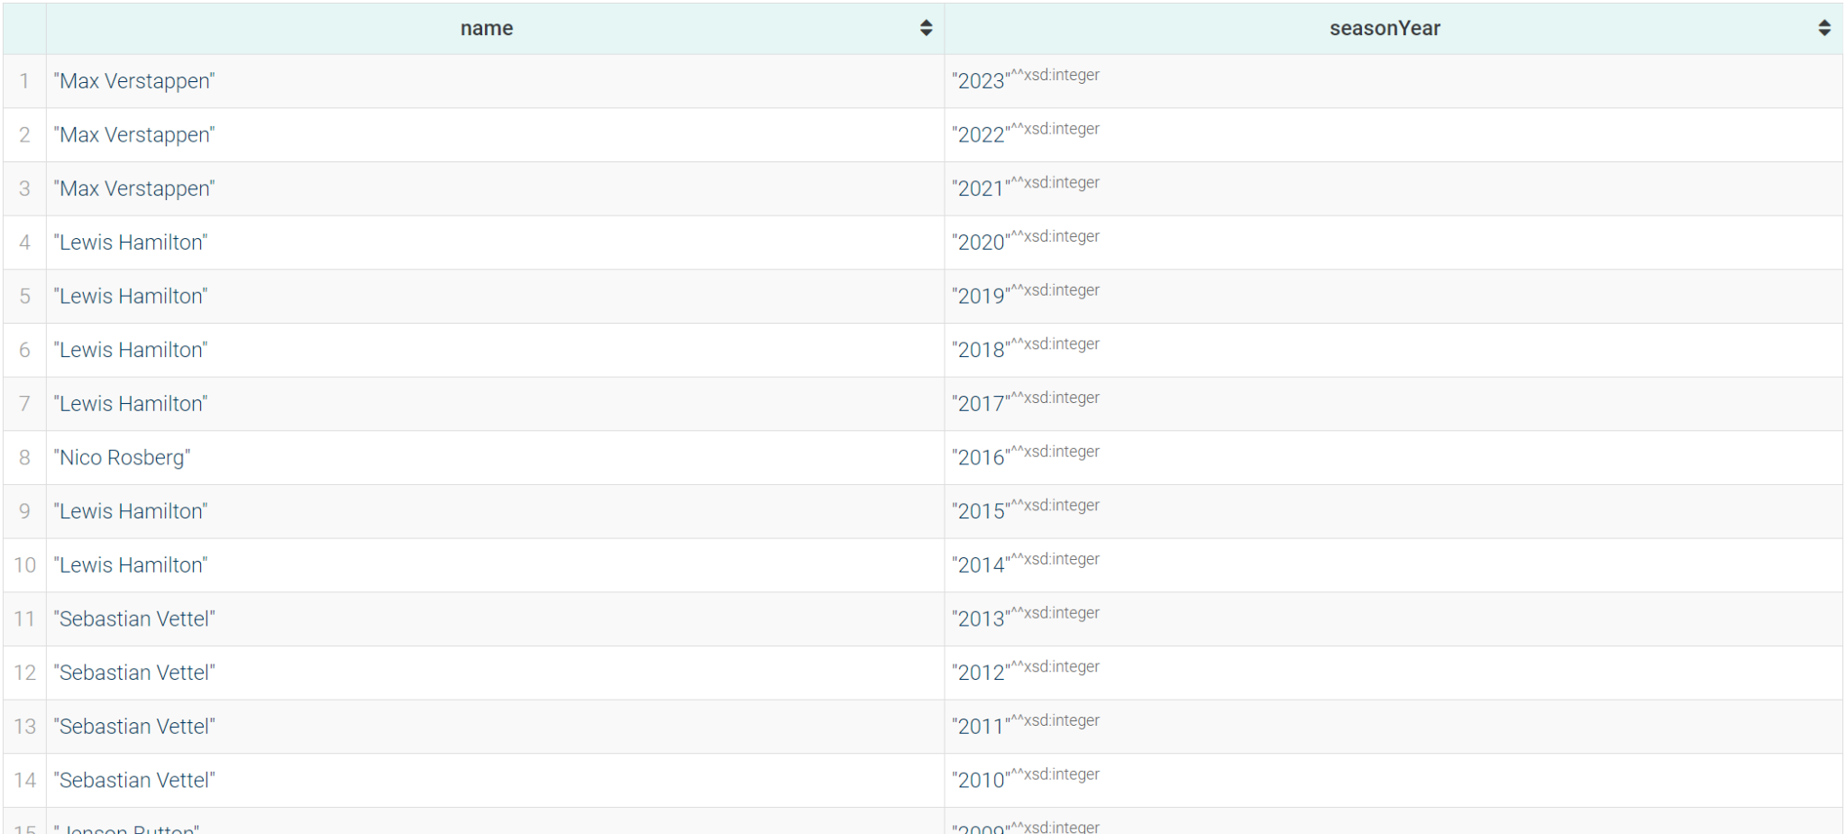
Every championship winner driver, ordered by season
Championship winning drivers who won more than 2 championships, ordered by number of championships won
PREFIX : <https://www.dei.unipd.it/db2/groupProject/FASTianF1#>
SELECT ?name (?outerYear AS ?seasonYear) WHERE{
?stand :hasRace ?race ;
:hasDriver ?driv ;
:hasTotalPosition ?pos .
?driv a :Driver;
:hasForename ?fname;
:hasSurname ?sname.
BIND(CONCAT(?fname, " ", ?sname) AS ?name).
?race :hasDate ?raceDate ;
:inSeason ?outerSeason ;
:hasRound ?outerRound .
?outerSeason :hasYear ?outerYear .
FILTER(?outerRound = ?maxRound && ?outerYear = ?year && ?pos = 1)
{
SELECT ?year (MAX(?round) AS ?maxRound) WHERE {
?race :inSeason ?season ;
:hasRound ?round .
?season :hasYear ?year .
}
GROUP BY ?year
}
}
ORDER BY DESC (?seasonYear)
PREFIX : <https://www.dei.unipd.it/db2/groupProject/FASTianF1#>
SELECT ?name (COUNT(?name) AS ?numOfWins) WHERE{
?stand :hasRace ?race ;
:hasDriver ?driv ;
:hasTotalPosition ?pos .
?driv a :Driver;
:hasForename ?fname;
:hasSurname ?sname.
BIND(CONCAT(?fname, " ", ?sname) AS ?name).
?race :hasDate ?raceDate ;
:inSeason ?outerSeason ;
:hasRound ?outerRound .
?outerSeason :hasYear ?outerYear .
FILTER(?outerRound = ?maxRound && ?outerYear = ?year && ?pos = 1)
{
SELECT ?year (MAX(?round) AS ?maxRound) WHERE {
?race :inSeason ?season ;
:hasRound ?round .
?season :hasYear ?year .
}
GROUP BY ?year
}
}
GROUP BY ?name
HAVING (?numOfWins > 2)
ORDER BY DESC (?numOfWins)

Slide 39
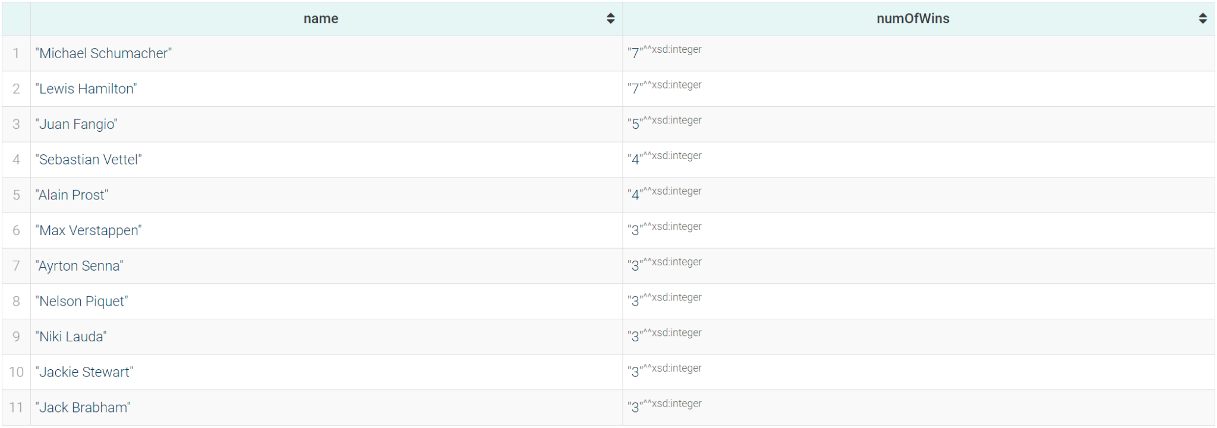
Every championship winner driver, ordered by season
Championship winning drivers who won more than 2 championships, ordered by number of championships won
PREFIX : <https://www.dei.unipd.it/db2/groupProject/FASTianF1#>
SELECT ?name (?outerYear AS ?seasonYear) WHERE{
?stand :hasRace ?race ;
:hasDriver ?driv ;
:hasTotalPosition ?pos .
?driv a :Driver;
:hasForename ?fname;
:hasSurname ?sname.
BIND(CONCAT(?fname, " ", ?sname) AS ?name).
?race :hasDate ?raceDate ;
:inSeason ?outerSeason ;
:hasRound ?outerRound .
?outerSeason :hasYear ?outerYear .
FILTER(?outerRound = ?maxRound && ?outerYear = ?year && ?pos = 1)
{
SELECT ?year (MAX(?round) AS ?maxRound) WHERE {
?race :inSeason ?season ;
:hasRound ?round .
?season :hasYear ?year .
}
GROUP BY ?year
}
}
ORDER BY DESC (?seasonYear)
PREFIX : <https://www.dei.unipd.it/db2/groupProject/FASTianF1#>
SELECT ?name (COUNT(?name) AS ?numOfWins) WHERE{
?stand :hasRace ?race ;
:hasDriver ?driv ;
:hasTotalPosition ?pos .
?driv a :Driver;
:hasForename ?fname;
:hasSurname ?sname.
BIND(CONCAT(?fname, " ", ?sname) AS ?name).
?race :hasDate ?raceDate ;
:inSeason ?outerSeason ;
:hasRound ?outerRound .
?outerSeason :hasYear ?outerYear .
FILTER(?outerRound = ?maxRound && ?outerYear = ?year && ?pos = 1)
{
SELECT ?year (MAX(?round) AS ?maxRound) WHERE {
?race :inSeason ?season ;
:hasRound ?round .
?season :hasYear ?year .
}
GROUP BY ?year
}
}
GROUP BY ?name
HAVING (?numOfWins > 2)
ORDER BY DESC (?numOfWins)

Slide 40
Winners of driver's championship and constructor's championship for each season.
Drivers who gained the most positions during a race after 2000
PREFIX : <https://www.dei.unipd.it/db2/groupProject/FASTianF1#>
SELECT ?outerYear ?driverName ?constructorName WHERE{
?driverStand :hasTotalPosition ?pos ;
:hasRace ?race ;
:hasDriver ?driver .
?constStand :hasTotalPosition ?pos ;
:hasRace ?race ;
:hasConstructor ?const .
?race :hasRound ?outerRound ;
:inSeason ?season .
?season :hasYear ?outerYear .
?driver :hasForename ?fname ;
:hasSurname ?sname .
?const :hasName ?constructorName .
BIND(CONCAT(?fname, " ", ?sname) AS ?driverName).
FILTER(?outerRound = ?maxRound && ?outerYear = ?year && ?pos = 1)
{
SELECT ?year (MAX(?round) AS ?maxRound) WHERE {
?race :inSeason ?season ;
:hasRound ?round .
?season :hasYear ?year .
}
GROUP BY ?year
}
}
ORDER BY DESC (?outerYear)
PREFIX : <https://www.dei.unipd.it/db2/groupProject/FASTianF1#>
SELECT ?driverName ?raceName ?year ?positionsGained WHERE{
?part :hasStartingGridPosition ?grid ;
:partecipatedInRace ?race ;
:hasDriver ?driver ;
:hasPosition ?pos .
?driver :hasForename ?fname ;
:hasSurname ?sname .
?race :inSeason ?season ;
:hasName ?raceName .
?season :hasYear ?year .
FILTER(?year >= 2000)
BIND((?grid - ?pos) AS ?positionsGained)
BIND(CONCAT(?fname, " ", ?sname) AS ?driverName)
}
ORDER BY DESC (?positionsGained)
LIMIT 50

Slide 41
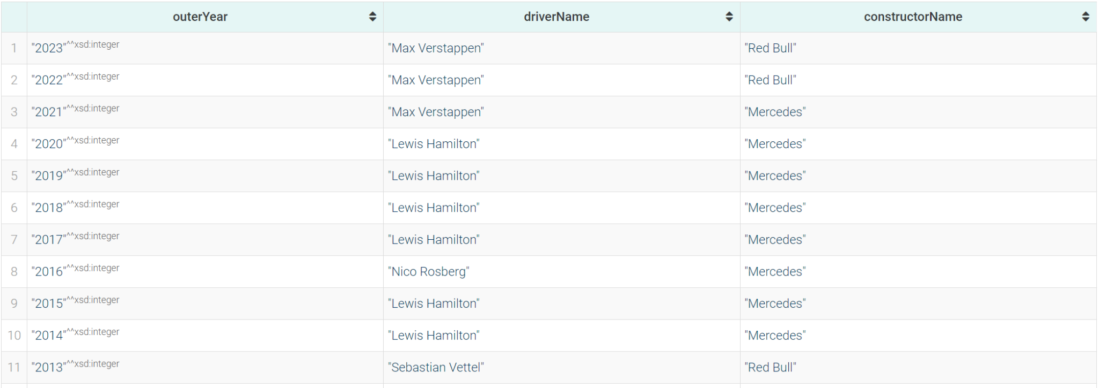
Winners of driver's championship and constructor's championship for each season.
Drivers who gained the most positions during a race after 2000
PREFIX : <https://www.dei.unipd.it/db2/groupProject/FASTianF1#>
SELECT ?outerYear ?driverName ?constructorName WHERE{
?driverStand :hasTotalPosition ?pos ;
:hasRace ?race ;
:hasDriver ?driver .
?constStand :hasTotalPosition ?pos ;
:hasRace ?race ;
:hasConstructor ?const .
?race :hasRound ?outerRound ;
:inSeason ?season .
?season :hasYear ?outerYear .
?driver :hasForename ?fname ;
:hasSurname ?sname .
?const :hasName ?constructorName .
BIND(CONCAT(?fname, " ", ?sname) AS ?driverName).
FILTER(?outerRound = ?maxRound && ?outerYear = ?year && ?pos = 1)
{
SELECT ?year (MAX(?round) AS ?maxRound) WHERE {
?race :inSeason ?season ;
:hasRound ?round .
?season :hasYear ?year .
}
GROUP BY ?year
}
}
ORDER BY DESC (?outerYear)
PREFIX : <https://www.dei.unipd.it/db2/groupProject/FASTianF1#>
SELECT ?driverName ?raceName ?year ?positionsGained WHERE{
?part :hasStartingGridPosition ?grid ;
:partecipatedInRace ?race ;
:hasDriver ?driver ;
:hasPosition ?pos .
?driver :hasForename ?fname ;
:hasSurname ?sname .
?race :inSeason ?season ;
:hasName ?raceName .
?season :hasYear ?year .
FILTER(?year >= 2000)
BIND((?grid - ?pos) AS ?positionsGained)
BIND(CONCAT(?fname, " ", ?sname) AS ?driverName)
}
ORDER BY DESC (?positionsGained)
LIMIT 50

Slide 42
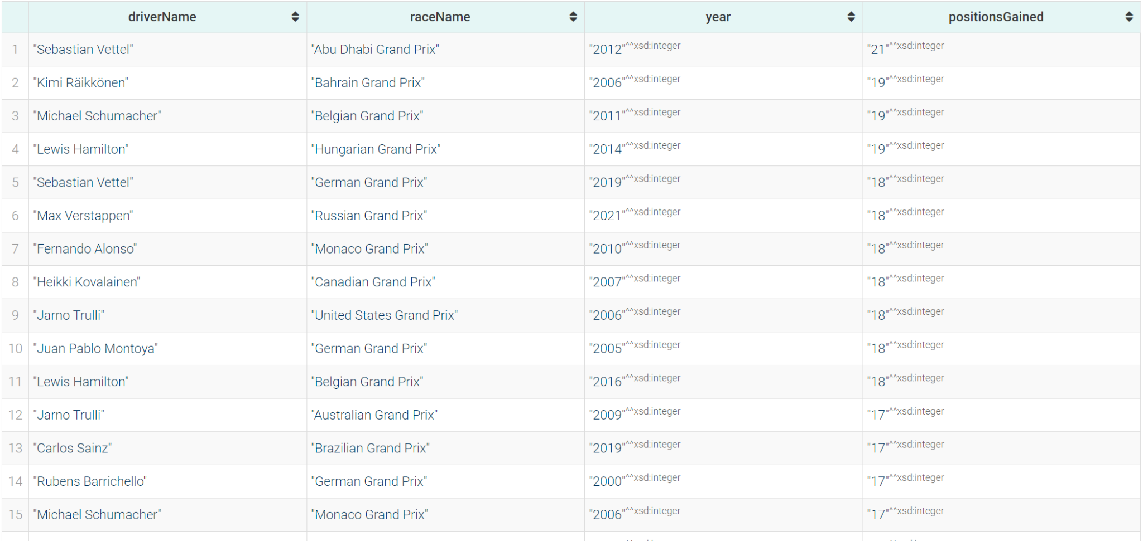
Winners of driver's championship and constructor's championship for each season.
Drivers who gained the most positions during a race after 2000
PREFIX : <https://www.dei.unipd.it/db2/groupProject/FASTianF1#>
SELECT ?outerYear ?driverName ?constructorName WHERE{
?driverStand :hasTotalPosition ?pos ;
:hasRace ?race ;
:hasDriver ?driver .
?constStand :hasTotalPosition ?pos ;
:hasRace ?race ;
:hasConstructor ?const .
?race :hasRound ?outerRound ;
:inSeason ?season .
?season :hasYear ?outerYear .
?driver :hasForename ?fname ;
:hasSurname ?sname .
?const :hasName ?constructorName .
BIND(CONCAT(?fname, " ", ?sname) AS ?driverName).
FILTER(?outerRound = ?maxRound && ?outerYear = ?year && ?pos = 1)
{
SELECT ?year (MAX(?round) AS ?maxRound) WHERE {
?race :inSeason ?season ;
:hasRound ?round .
?season :hasYear ?year .
}
GROUP BY ?year
}
}
ORDER BY DESC (?outerYear)
PREFIX : <https://www.dei.unipd.it/db2/groupProject/FASTianF1#>
SELECT ?driverName ?raceName ?year ?positionsGained WHERE{
?part :hasStartingGridPosition ?grid ;
:partecipatedInRace ?race ;
:hasDriver ?driver ;
:hasPosition ?pos .
?driver :hasForename ?fname ;
:hasSurname ?sname .
?race :inSeason ?season ;
:hasName ?raceName .
?season :hasYear ?year .
FILTER(?year >= 2000)
BIND((?grid - ?pos) AS ?positionsGained)
BIND(CONCAT(?fname, " ", ?sname) AS ?driverName)
}
ORDER BY DESC (?positionsGained)
LIMIT 50

Slide 43
Drivers ordered by pole-to-win percentage (percentage of races won starting from the first position in grid)
Drivers who finished first in a race and were placed in the last quarter in the standing of the previous race.
PREFIX : <https://www.dei.unipd.it/db2/groupProject/FASTianF1#>
SELECT ?name ?numOfPoleWins ?numOfPoles ?winPercentage WHERE{
{
SELECT ?name (COUNT(?name) AS ?numOfPoleWins) WHERE{
?racePart :partecipatedInRace ?race ;
:hasDriver ?driv ;
:hasStartingGridPosition ?startPos ;
:hasPosition ?pos .
?driv a :Driver;
:hasForename ?fname;
:hasSurname ?sname.
BIND(CONCAT(?fname, " ", ?sname) AS ?name).
FILTER(?startPos = 1 && ?pos = 1)
}
GROUP BY ?name
}
{
SELECT ?name (COUNT(?name) AS ?numOfPoles) WHERE{
?racePart :partecipatedInRace ?race ;
:hasDriver ?driv ;
:hasStartingGridPosition ?startPos .
?driv a :Driver;
:hasForename ?fname;
:hasSurname ?sname.
BIND(CONCAT(?fname, " ", ?sname) AS ?name).
FILTER(?startPos = 1)
}
GROUP BY ?name
}
BIND((?numOfPoleWins / ?numOfPoles) * 100 AS ?winPercentage)
}
ORDER BY DESC (?winPercentage)
PREFIX : <https://www.dei.unipd.it/db2/groupProject/FASTianF1#>
SELECT ?driverName ?raceName ?round ?year WHERE{
?race :hasRound ?round ;
:inSeason ?season ;
:hasName ?raceName .
?part :partecipatedInRace ?race ;
:hasPosition ?pos ;
:hasDriver ?driver .
?driver :hasForename ?fname ;
:hasSurname ?lname .
?season :hasYear ?year .
BIND((?round-1) AS ?prevRound)
BIND(CONCAT(?fname," ",?lname) AS ?driverName)
FILTER(?pos = 1 && EXISTS{
?prevRace :hasRound ?prevRound ;
:inSeason ?season .
?stand :hasRace ?prevRace ;
:hasDriver ?driver ;
:hasTotalPosition ?totPos .
FILTER (?totPos >= ((?maxPos/4)*3) && ?prevRace = ?raceMax)
{
SELECT ?raceMax (MAX(?totPos) AS ?maxPos) WHERE {
?standing a :DriverStanding ;
:hasRace ?raceMax ;
:hasTotalPosition ?totPos .
}
GROUP BY ?raceMax
}
})
}
ORDER BY (?year)

Slide 44
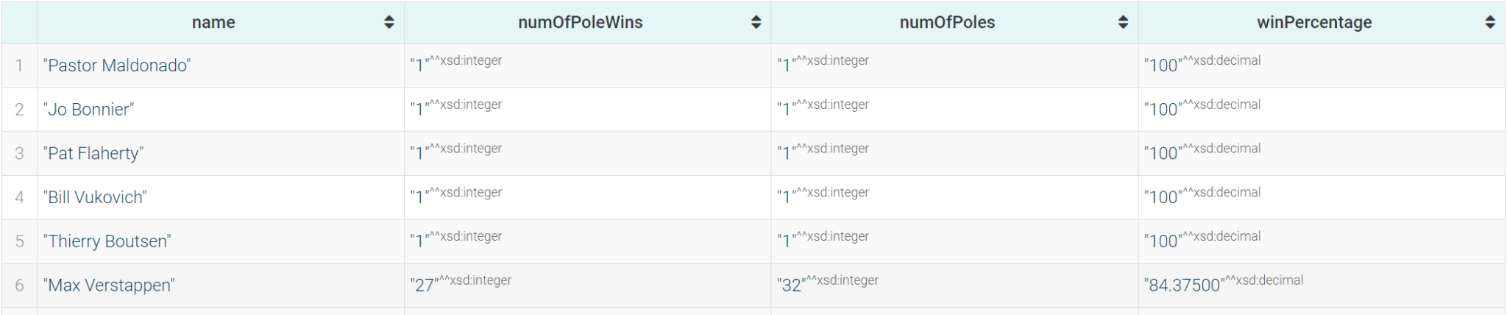
Drivers ordered by pole-to-win percentage (percentage of races won starting from the first position in grid)
Drivers who finished first in a race and were placed in the last quarter in the standing of the previous race.
PREFIX : <https://www.dei.unipd.it/db2/groupProject/FASTianF1#>
SELECT ?name ?numOfPoleWins ?numOfPoles ?winPercentage WHERE{
{
SELECT ?name (COUNT(?name) AS ?numOfPoleWins) WHERE{
?racePart :partecipatedInRace ?race ;
:hasDriver ?driv ;
:hasStartingGridPosition ?startPos ;
:hasPosition ?pos .
?driv a :Driver;
:hasForename ?fname;
:hasSurname ?sname.
BIND(CONCAT(?fname, " ", ?sname) AS ?name).
FILTER(?startPos = 1 && ?pos = 1)
}
GROUP BY ?name
}
{
SELECT ?name (COUNT(?name) AS ?numOfPoles) WHERE{
?racePart :partecipatedInRace ?race ;
:hasDriver ?driv ;
:hasStartingGridPosition ?startPos .
?driv a :Driver;
:hasForename ?fname;
:hasSurname ?sname.
BIND(CONCAT(?fname, " ", ?sname) AS ?name).
FILTER(?startPos = 1)
}
GROUP BY ?name
}
BIND((?numOfPoleWins / ?numOfPoles) * 100 AS ?winPercentage)
}
ORDER BY DESC (?winPercentage)
PREFIX : <https://www.dei.unipd.it/db2/groupProject/FASTianF1#>
SELECT ?driverName ?raceName ?round ?year WHERE{
?race :hasRound ?round ;
:inSeason ?season ;
:hasName ?raceName .
?part :partecipatedInRace ?race ;
:hasPosition ?pos ;
:hasDriver ?driver .
?driver :hasForename ?fname ;
:hasSurname ?lname .
?season :hasYear ?year .
BIND((?round-1) AS ?prevRound)
BIND(CONCAT(?fname," ",?lname) AS ?driverName)
FILTER(?pos = 1 && EXISTS{
?prevRace :hasRound ?prevRound ;
:inSeason ?season .
?stand :hasRace ?prevRace ;
:hasDriver ?driver ;
:hasTotalPosition ?totPos .
FILTER (?totPos >= ((?maxPos/4)*3) && ?prevRace = ?raceMax)
{
SELECT ?raceMax (MAX(?totPos) AS ?maxPos) WHERE {
?standing a :DriverStanding ;
:hasRace ?raceMax ;
:hasTotalPosition ?totPos .
}
GROUP BY ?raceMax
}
})
}
ORDER BY (?year)

Slide 45
Drivers ordered by pole-to-win percentage (percentage of races won starting from the first position in grid)
Drivers who finished first in a race and were placed in the last quarter in the standing of the previous race.
PREFIX : <https://www.dei.unipd.it/db2/groupProject/FASTianF1#>
SELECT ?name ?numOfPoleWins ?numOfPoles ?winPercentage WHERE{
{
SELECT ?name (COUNT(?name) AS ?numOfPoleWins) WHERE{
?racePart :partecipatedInRace ?race ;
:hasDriver ?driv ;
:hasStartingGridPosition ?startPos ;
:hasPosition ?pos .
?driv a :Driver;
:hasForename ?fname;
:hasSurname ?sname.
BIND(CONCAT(?fname, " ", ?sname) AS ?name).
FILTER(?startPos = 1 && ?pos = 1)
}
GROUP BY ?name
}
{
SELECT ?name (COUNT(?name) AS ?numOfPoles) WHERE{
?racePart :partecipatedInRace ?race ;
:hasDriver ?driv ;
:hasStartingGridPosition ?startPos .
?driv a :Driver;
:hasForename ?fname;
:hasSurname ?sname.
BIND(CONCAT(?fname, " ", ?sname) AS ?name).
FILTER(?startPos = 1)
}
GROUP BY ?name
}
BIND((?numOfPoleWins / ?numOfPoles) * 100 AS ?winPercentage)
}
ORDER BY DESC (?winPercentage)
PREFIX : <https://www.dei.unipd.it/db2/groupProject/FASTianF1#>
SELECT ?driverName ?raceName ?round ?year WHERE{
?race :hasRound ?round ;
:inSeason ?season ;
:hasName ?raceName .
?part :partecipatedInRace ?race ;
:hasPosition ?pos ;
:hasDriver ?driver .
?driver :hasForename ?fname ;
:hasSurname ?lname .
?season :hasYear ?year .
BIND((?round-1) AS ?prevRound)
BIND(CONCAT(?fname," ",?lname) AS ?driverName)
FILTER(?pos = 1 && EXISTS{
?prevRace :hasRound ?prevRound ;
:inSeason ?season .
?stand :hasRace ?prevRace ;
:hasDriver ?driver ;
:hasTotalPosition ?totPos .
FILTER (?totPos >= ((?maxPos/4)*3) && ?prevRace = ?raceMax)
{
SELECT ?raceMax (MAX(?totPos) AS ?maxPos) WHERE {
?standing a :DriverStanding ;
:hasRace ?raceMax ;
:hasTotalPosition ?totPos .
}
GROUP BY ?raceMax
}
})
}
ORDER BY (?year)

Slide 46
Thank you!

